Slide 1

What you need to know about the
delegated regulation supplementing the EECC
Benoit VIVIER, Public Affairs Manager, EENA

Slide 2
On the programme today…
Introduction: basics of EU legislations
Introduction: EU law on emergency communications
Content of the delegated regulation
Summary
  SDF

Slide 3
Introduction: different norms in EU law
Directives
Regulations
Delegated acts
Other norms

Slide 4
Introduction: different norms in EU law
Directives
  Mandatory
  Require transposition into the Member States’ national law
Regulations
Delegated acts
Other norms

Slide 5
Introduction: different norms in EU law
Directives
Regulations
  Mandatory
  Self-executive (does not require transposition into Member States’ national law)
Delegated acts
Other norms

Slide 6
Introduction: different norms in EU law
Directives
Regulations
Delegated acts
  Mandatory
  Can only modify the non-essential elements of a directive or regulation
  Aims to complete specific provisions of a directive/regulation
  Power explicitly delegated to the European Commission to adopt such acts
Other norms

Slide 7
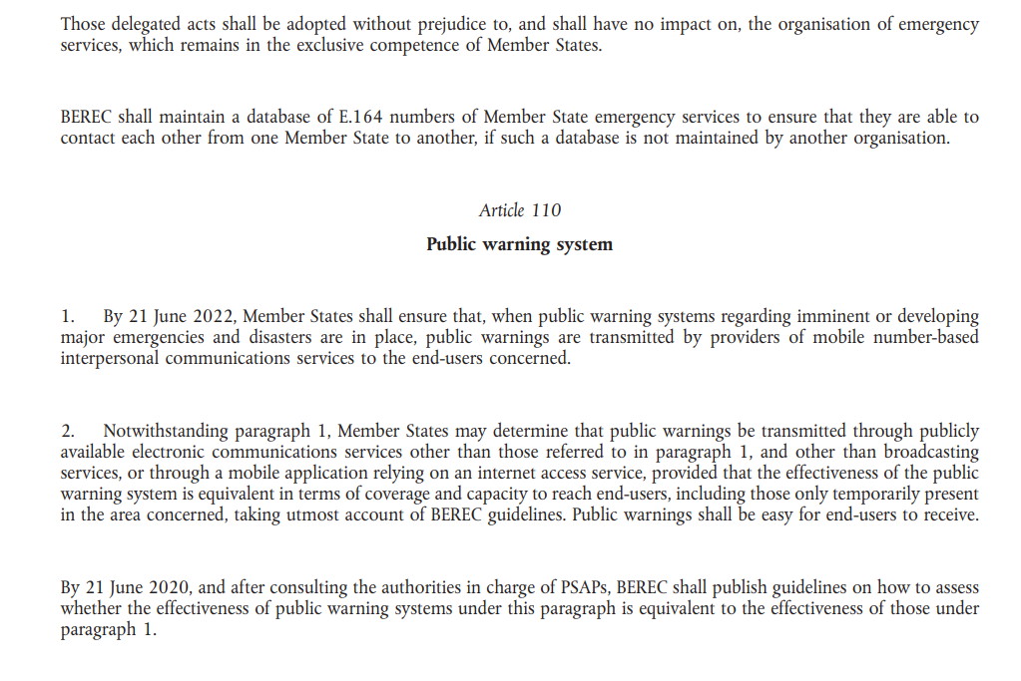
Introduction: how to read EU law
Articles
Binding elements of a legislation
Important note:
Shall = mandatory
May = optional

Slide 8
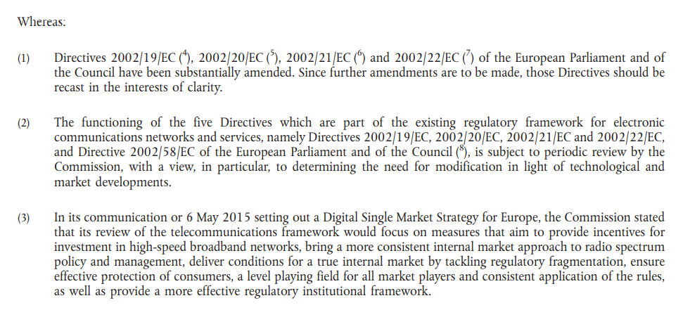
Introduction: how to read EU law
Recitals
Not binding as such but gives justifications for a provision and key hints on how to interpret the articles.

Slide 9
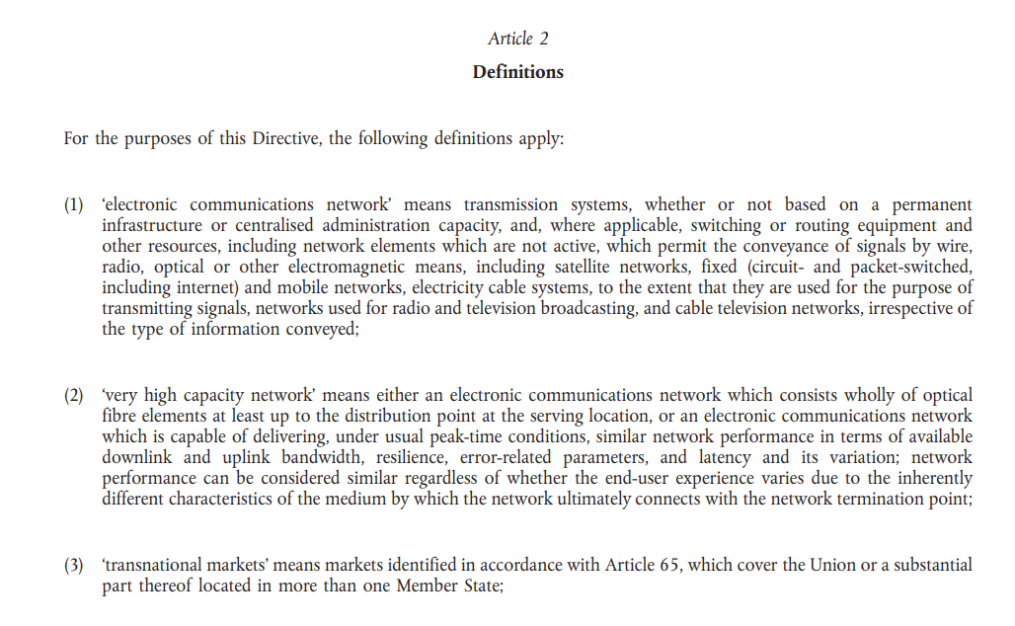
Introduction: how to read EU law
Definitions

Slide 10
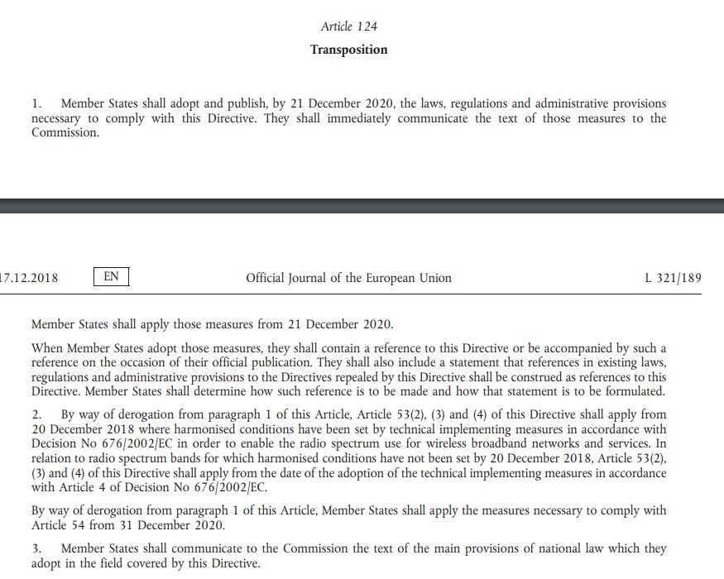
Introduction: how to read EU law
Deadlines

Slide 11


Slide 12
Introduction: EU law on emergency communications
2017
2018
2019
2020
2021
2022
2023
2024
EECC
Article 109
Delegated act
Article 110
EU Accessibility Act
Roaming Regulation
Del. reg. Radio Equipment Directive
New eCall regulation

Slide 13
Introduction: European Electronic Communications Code
Article 108: Uninterrupted access to emergency services
Article 109: Emergency communications
Accessibility free of charge of 112 in all the EU.
Routing of emergency communications to the most appropriate PSAP.
112 handling in the « manner best suited to the national organisation of emergency systems. »
Mandatory report of the European Commission on the implementation of 112.
Accessibility for people with disabilities
Caller location information
Promotion of 112
PSAP Directory + Delegation to the European Commission to adopt delegated acts
Article 110: Public Warning Systems

Slide 14
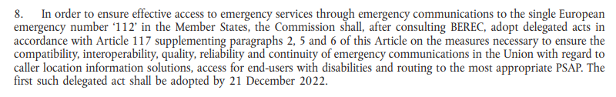
Introduction: European Electronic Communications Code
Article 109(8):

Slide 15


Slide 16

Caller location

Slide 17
Caller location
Recall of the obligations on national authorities to establish caller location accuracy and reliability criteria.
Article 3(1)
“When laying down criteria for the accuracy and reliability of caller location information pursuant to Article 109 (6) of Directive EU 2018/1972, competent regulatory authorities shall ensure, within the limits of technical feasibility, that the end-user’s position is located as reliably and accurately as is necessary to enable the emergency services to come to the end-user’s assistance."

Slide 18
Caller location
Criteria adopted should ensure that the location is precise enough for emergency services to assist the victim. This also applies to network-based location.
Recital 7:
“[…] the criteria should ensure, within the limits of technical feasibility, that the end-user’s position is located as reliably and accurately as is necessary to enable the emergency services to usefully come to the end-user’s assistance. The mix of these technologies ensures that even where a handset-derived caller location solution fails to make the caller location information available to the most appropriate PSAP, emergency services can rely on network-based location to usefully come to the end-user’s assistance, in line with the caller location accuracy and reliability criteria established by Member States."

Slide 19
Caller location
Criteria should be expressed in “x % of emergency communications providing a location within x meters” for mobile networks.
National authorities may also adopt vertical criteria.
Article 3(3):
“With respect to the mobile networks:
(a) the accuracy criterion for caller location information shall be expressed in metres. If applicable, the elevation or vertical accuracy criterion shall be expressed in metres as well;
(b) the reliability criterion for caller location information shall be expressed as the success rate, in percentage, of the technical solution or mix of technical solutions to establish and transmit to the most appropriate PSAP a search area corresponding to the accuracy criterion."

Slide 20
Caller location
Article 3(2):
“With respect to the fixed networks:
(a) the accuracy criterion for caller location information shall be expressed as information related to the physical address of the network termination point;
(b) the reliability criterion for caller location information shall be expressed as the success rate, in percentage, of the technical solution or mix of technical solutions to establish and transmit to the most appropriate PSAP a caller location information corresponding to the accuracy criterion."
Criteria should be related to the physical address of the network termination point for fixed networks.

Slide 21
Caller location
Article 3(2):
“Member States shall report to the Commission no later than [one year after entry into force of this Regulation]:
(a) the criteria for the accuracy and reliability of caller location information expressed according to the parameters referred to in Article 3, […]"
Deadline to adopt these criteria: 1 year
Authorities to report these criteria to the European Commission

Slide 22
Caller location
Recital 7:
Moreover, it is important to recall that pursuant to the principle of sincere cooperation laid down in Article 4(3) of the Treaty on European Union, competent regulatory authorities are to cooperate among each other when laying down the criteria for the accuracy and reliability of the caller location information by consulting the Body of European Regulators for Electronic Communications (BEREC) or other relevant fora competent to provide guidance in this regard, in order to ensure the full effectiveness of Article 109(6) of Directive (EU) 2018/1972."
Towards European cooperation on this matter?

Slide 23
Caller location
Towards European cooperation on this matter? Not in the short term
  No concrete action has been taken by any official organisation on this matter.
  Some organisations consider they lack competence to work on this matter and the legislation is not directive enough to trigger an action.
  At the same time… time is running out

Slide 24
Caller location
How EENA intends to assist national authorities in defining caller location criteria
  EENA will work with relevant stakeholders to provide recommendations on caller location criteria derived from handsets which could be adopted. The work will not look at other types of location (network based, fixed networks…)
  First work to be presented at the EENA Conference
  Publication of EENA’s work is scheduled for September 2023

Slide 25

Accessibility

Slide 26
Accessibility
Reminder of current EU legislations:
  EECC: Access to emergency services should be equivalent for people with disabilities compared to other end-users.
  Accessibility Act: Real-Time Text to be deployed by 2027.
  Roaming Regulation: Accessibility means to work when roaming + such means to be promoted when entering another Member State.

Slide 27
Accessibility
Reminder of current EU legislations:
  EECC: Access to emergency services should be equivalent for people with disabilities compared to other end-users.
  Accessibility Act: Real-Time Text to be deployed by 2027.
  Roaming Regulation: Accessibility means to work when roaming + such means to be promoted when entering another Member State.
The delegated act defines what this means

Slide 28
Accessibility
Functional equivalence requirements:
Emergency communication enables two-way interactive communication between the end-user and the PSAP.
Emergency comm is available in a seamless way, without pre-registration to end-users travelling in another Member State.
Emergency comm is provided free of charge to the end-user.
Emergency comm routed without delay to the most appropriate PSAP.
Equivalent levels of caller location information.
Awareness raising measures

Slide 29
Accessibility
Article 8:
“Member States shall report to the Commission no later than [one year after entry into force of this Regulation]:
[…]
(b) the means of access to emergency services through emergency communications to be used by end-users with disabilities, including those using roaming services, and the assessment of their compliance with the functional equivalence requirements in Article 5.”
Member States to assess and report how accessibility means meet the functional requirements

Slide 30
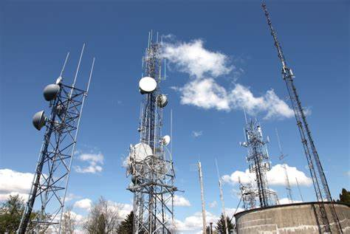
Routing to the most appropriate PSAP

Slide 31
Routing to the most appropriate PSAP
New concept: contextual information
Article 2(2):
“‘contextual information’ means the information conveyed through an emergency communication by the end-user or derived and transmitted automatically from the device of the end-user or the relevant network in order to enable the timely identification of the intervention resources of the emergency services and the fast arrival of the emergency services at the intervention scene.”
Notes:
Incl: caller location, description of the emergency incident, physical environment, condition and abilities of the rpersons involved… (recital 5)

Slide 32
Routing to the most appropriate PSAP
Article 5:
“Member States shall ensure that emergency communications and caller location information are routed without delay to the most appropriate PSAP that is technically capable to convey the contextual information to the emergency services when alerting those services.”
Stage-1 PSAPs should be able to transmit caller location and other contextual information to emergency services.

Slide 33
Routing to the most appropriate PSAP
Article 8:
“For the purpose of ensuring the technical feasibility of the seamless access to emergency services as provided in Article 4(1), point (b) of this Regulation, without prejudice to the implementation of Directive (EU) 2019/882, Member States shall cooperate with the Commission to identify common interoperability requirements that enable the emergency communication to the most appropriate PSAP via a mobile application anywhere in the Union.”
Member States to cooperate with the European Commission to identify common interoperability requirements for mobile apps.

Slide 34

Towards NG112

Slide 35
Towards NG112
Article 7(2):
“Member States shall prepare and report to the Commission no later than [nine months after entry into force of this Regulation] a roadmap for upgrading the national PSAP system in order to be able to receive, answer and process emergency communications through packet-switched technology. The roadmap shall indicate the date of the expected deployment of voice, text or video based emergency communications through packet-switched technologies. The roadmap shall also include the indicative date by when PSAPs will be ready to receive such emergency communications.”
Member States to adopt a roadmap on the migration to NG112 (emergency comms through packet-switched technologies).

Slide 36
Towards NG112
The roadmap should contain (recital 17):
  Expected timeline and date of deployment of emergency communications through packet-switched technologies;
  Whether these are enabled in the core network or via a mobile application;
  Timeline of the upgrade of the capabilities of the PSAP systems;
  Expected legal mandate;
  Intermediary milestones (public and stakeholder consultations, legislative measures, interoperability, public procurement…)
  Any interoperability or continuity issue
Deadline: 9 months after the entry into force of the legislation.

Slide 37

To sum up

Slide 38
To sum up
Improvements on caller location
Precisions on what equivalent access means
Conveyance of contextual information from PSAP to appropriate emergency service

Slide 39
To sum up
  Member States to adopt:
  Accuracy and reliability caller location criteria for communications provided by fixed networks and mobile networks.
  Member States to report to the European Commission on:
  Roadmap on the transition to emergency comms through packet-switched technologies
  Caller location requirements adopted
  Assessment of how the means of access to emergency services for people with disabilities meet the functional equivalence criteria detailed in the legislation.
  Performance of the routing of emergency communications and caller location information to the most appropriate PSAP
  Member States to cooperate with the European Commission to:
  identify common interoperability requirements for mobile apps

Slide 40
Next steps
16 Dec 2022: Adoption of the Delegated Regulation by the Commission.
16 Feb 2022: Deadline for European Parliament and Council of the EU to make objections to the text.
Few days after: Publication in the Official Journal of the EU.
Early March 2023 (tbc): Entry into force

Slide 41
Next steps
T0: MAR 2023
T0+9 months: DEC 2023
T0+12 months: MAR 2024
Estimated date of entry into force
Roadmap on migration to NG112
Adoption of caller location criteria
Report on accessibility means

Slide 42


Slide 43



CONTACT
Benoit VIVIER
Public Affairs Manager, EENA
@BenoitVivier
bv@eena.org
Benoit Vivier

