Slide 1
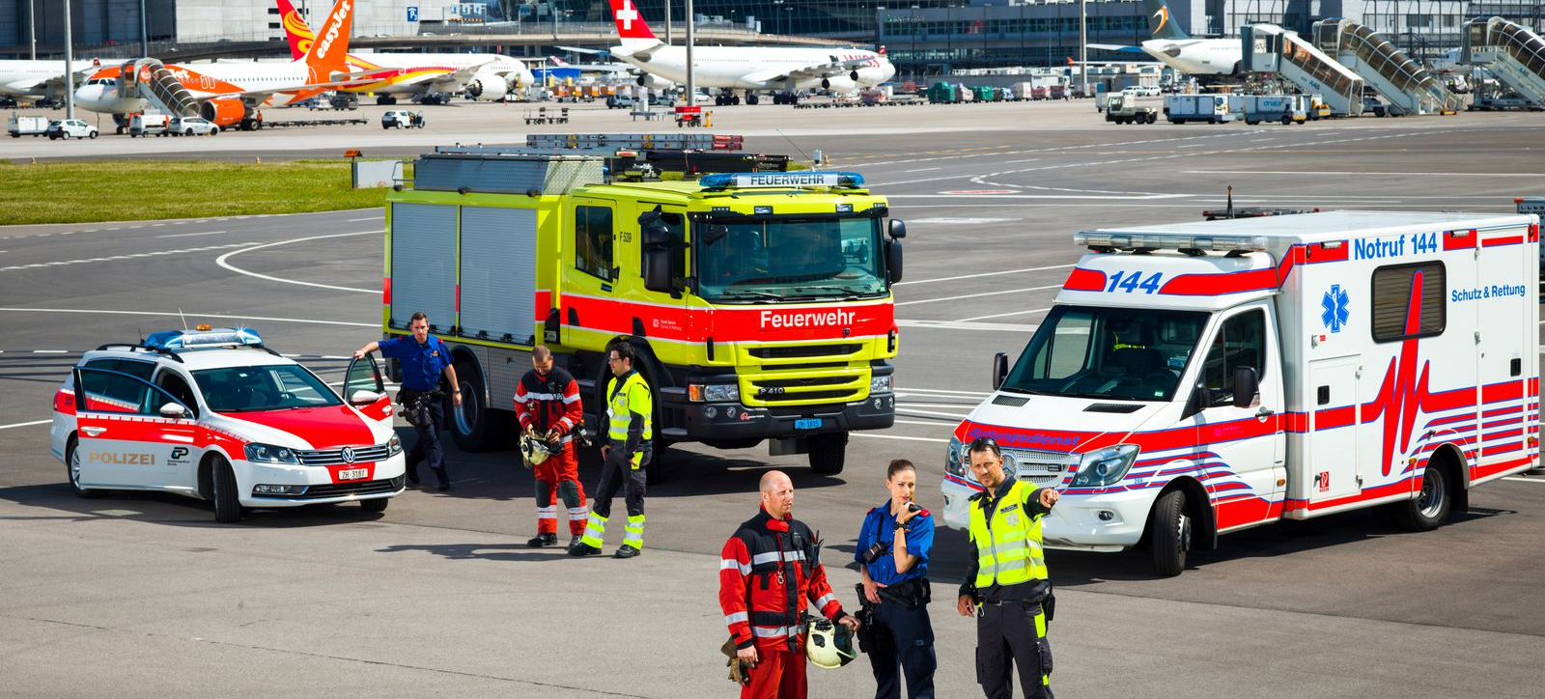
Emergency Call Steering Committee
09.04.2024 / Andreas Beeler / Gregor Gysi
EENA Webinar: PSAP Innovation Series:
Episode 2 - Protection & Rescue Zurich

Slide 2
Agenda
1 | Emergency call network Switzerland
2 | Organisation of emergency calls
3 | Status NG112 in Switzerland
4 | NG112 @ECC144&118 (Protection and Rescue Zurich)
5 | Challenges from the PSAP perspective
 | 5.1 End devices - IoT / OTT
 | 5.2 Barrier-free communication
 | 5.3 Reference model CH
 | 3.4 Switching off 2G/3G - emergency calls via 4G/5G and upcoming

Slide 3
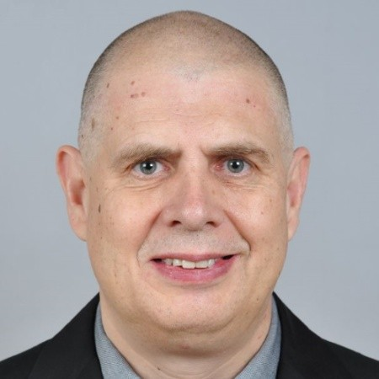
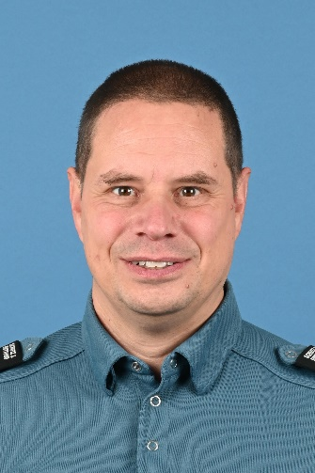
Who we are
Andreas Beeler
  PTI, Police Technology and Information Technology Switzerland
  https://www.pti-tip.ch
  Head of Telecommunications
  (Confederation & Cantons)
  andreas.beeler@pti-mail.ch
  https://ch.linkedin.com/in/andreas-beeler-0a436790
Gregor Gysi
  Protection & Rescue Zurich
  https://www.stadt-zuerich.ch/srz
  First lieutenant Gregor Gysi
  Technical head/deputy head EOCC
  gregor.gysi@zuerich.ch
  https://www.linkedin.com/in/gregor-gysi-9b15111/

Slide 4
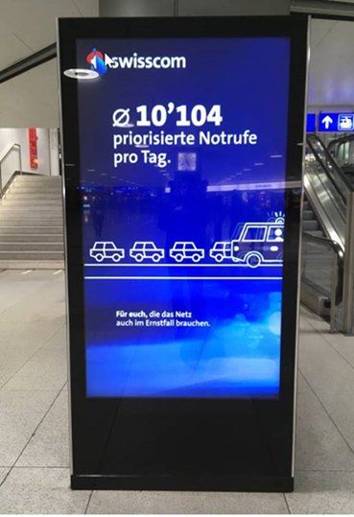
1 Emergency call network Switzerland
Every second counts in an emergency
There are 7 official emergency numbers in Switzerland:
  112 European emergency number
  117 Police
  118 Fire brigade
  144 Ambulance
  143 Offered hand
  145 Tox
  147 Pro Juventute
  Facts:
  approx. 10’000 – 12’000 emergency calls daily
  4’146’646 emergency calls in 2023
  NG112 LIS proxy changeover successfully implemented

Slide 5
2 Organisation of emergency calls
The organisation of emergency calls
  All matters relating to the police (112 & 117), fire service (118) and ambulance 144 emergency numbers are coordinated by the Emergency Calls organisation. It is the point of contact for emergency calls and represents the concerns of the emergency call organisations. It defines the technical and operational standards.
  The "Emergency Calls Organisation" works on behalf of the Conference of Cantonal Police Commanders (KKPKS), the "Interassociation for Rescue Services" (Interverband für Rettungswesen, IVR) and the " Fire Service Coordination Switzerland" (Feuerwehr Koordination Schweiz, FKS).
  With the "Emergency Call Strategy" of 3 February 2016, the KKPKS, the IVR and the FKS identified the strategic fields of action in the area of emergency calls in Switzerland and recommended numerous measures for implementation. This strategy was subsequently approved and endorsed at political level by the responsible government conferences KKJPD (police), GDK (Ambulance) and RK MZF (Fire service).

Slide 6
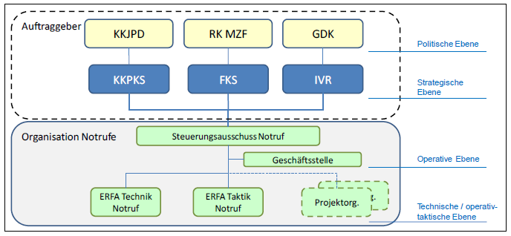
2 Organisation of emergency calls
The organisation chart of the Emergency Calls organisation

Slide 7
2 Organisation of emergency calls
The organisation chart of the Emergency Calls organisation
  The emergency call steering committee
  The emergency call steering committee is the highest operational authority in the area of emergency call services and is made up of representatives of the user organisations and regulatory authority.
  The ERFA technique
  It reviews the operational and tactical requirements with regard to technical feasibility. It develops technical standards and specifications.
  The ERFA tactic
  It defines the operational and tactical requirements in relation to operational implementation. It develops operational and tactical standards and guidelines.
  The business office
  PTI Switzerland acts as the business office of the Emergency Calls organisation. The office takes minutes of the meetings of the steering committee and supports it in organisational and administrative matters. It is also the contact and triage centre for enquiries.

Slide 8
3 Status NG112 in Switzerland
  NG112 (eCall112 with MSD & AML) has been successfully introduced nationwide in Switzerland as of 13 January 2024.
  All 55 PSAPs in Switzerland productively access the central LIS proxy to obtain the localisation and MSD data.
  All Swiss MNOs provide the localisation and MSD data via a central LIS proxy.
  All national and international emergency numbers that are authorised in Switzerland are supported.
  NG112 is activated and productive for iOS, Android and Harmony.
  Thanks to the support of all parties involved (PSAP, VSP, regulatory authority), the project was successfully implemented on time and on budget within two years.

Slide 9
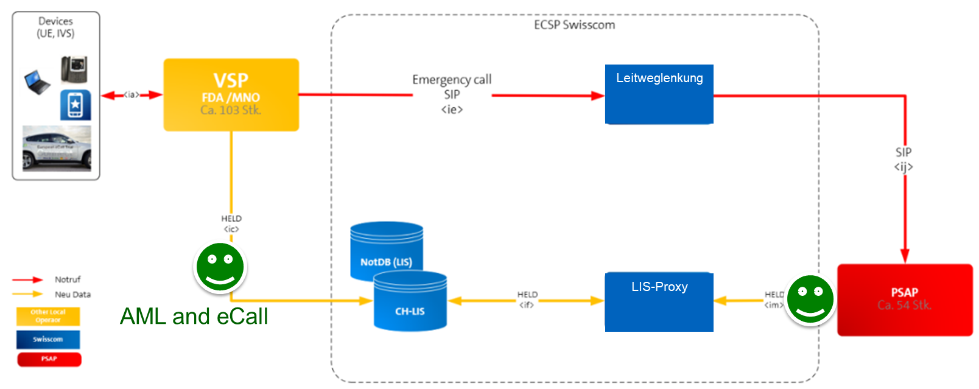
3 Status NG112 in Switzerland

Slide 10
NG112 @ ECC 144 and 118
It works…
Protection & Rescue Zurich

Slide 11
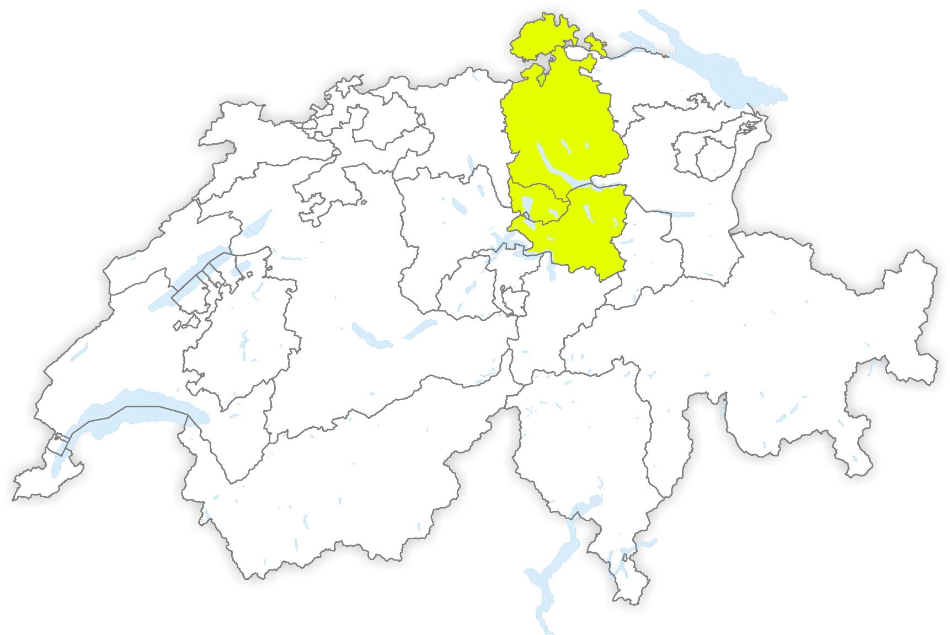
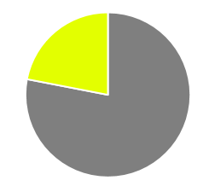



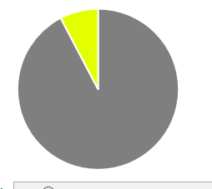
ECC Protection & Rescue Zurich
Facts and figures 2022
Disposition of emergency calls
…of around 2.0 million people, around 22% of the Swiss population
…an area that corresponds to 7.6% of the country (3'147 km²).
41'285 km²
168'798
Emergency calls (ambulance/fire)
364'939
Incoming calls
58
Operators @ ECC
Notes:
“Schutz & Rettung Zürich” is the largest professional rescue organisation for medical services, fire brigade and civil protection in Switzerland.
Part of Security department city of Zurich

Slide 12
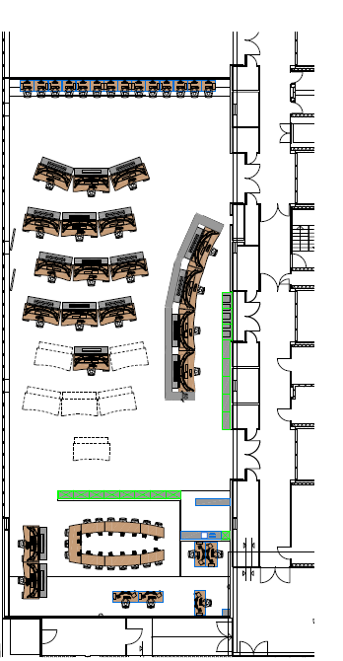


Roles @ ECC
TOC
Calltaking
Medical transports
SL 24h
Dispatch 118+144
Extended workplaces

Slide 13
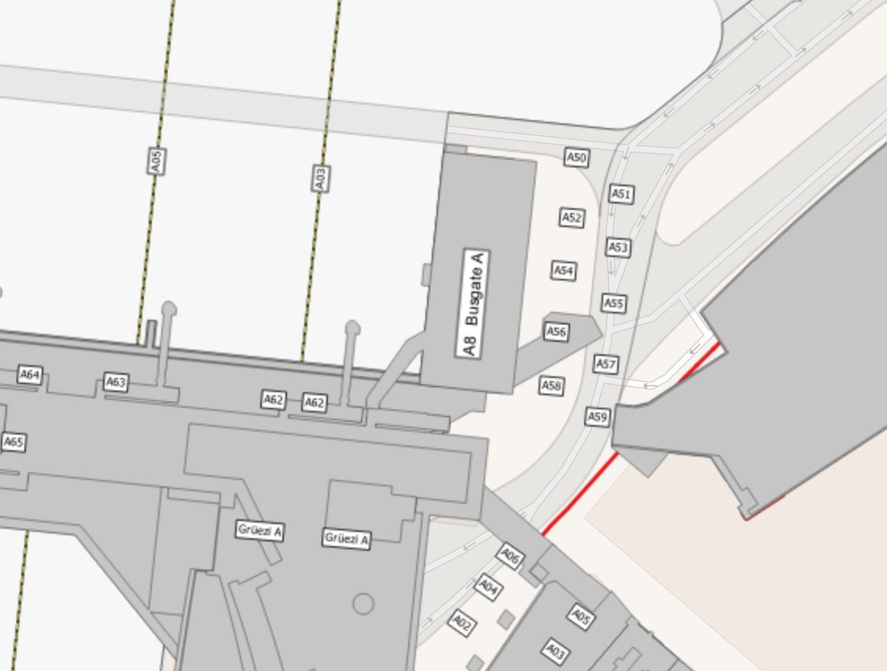
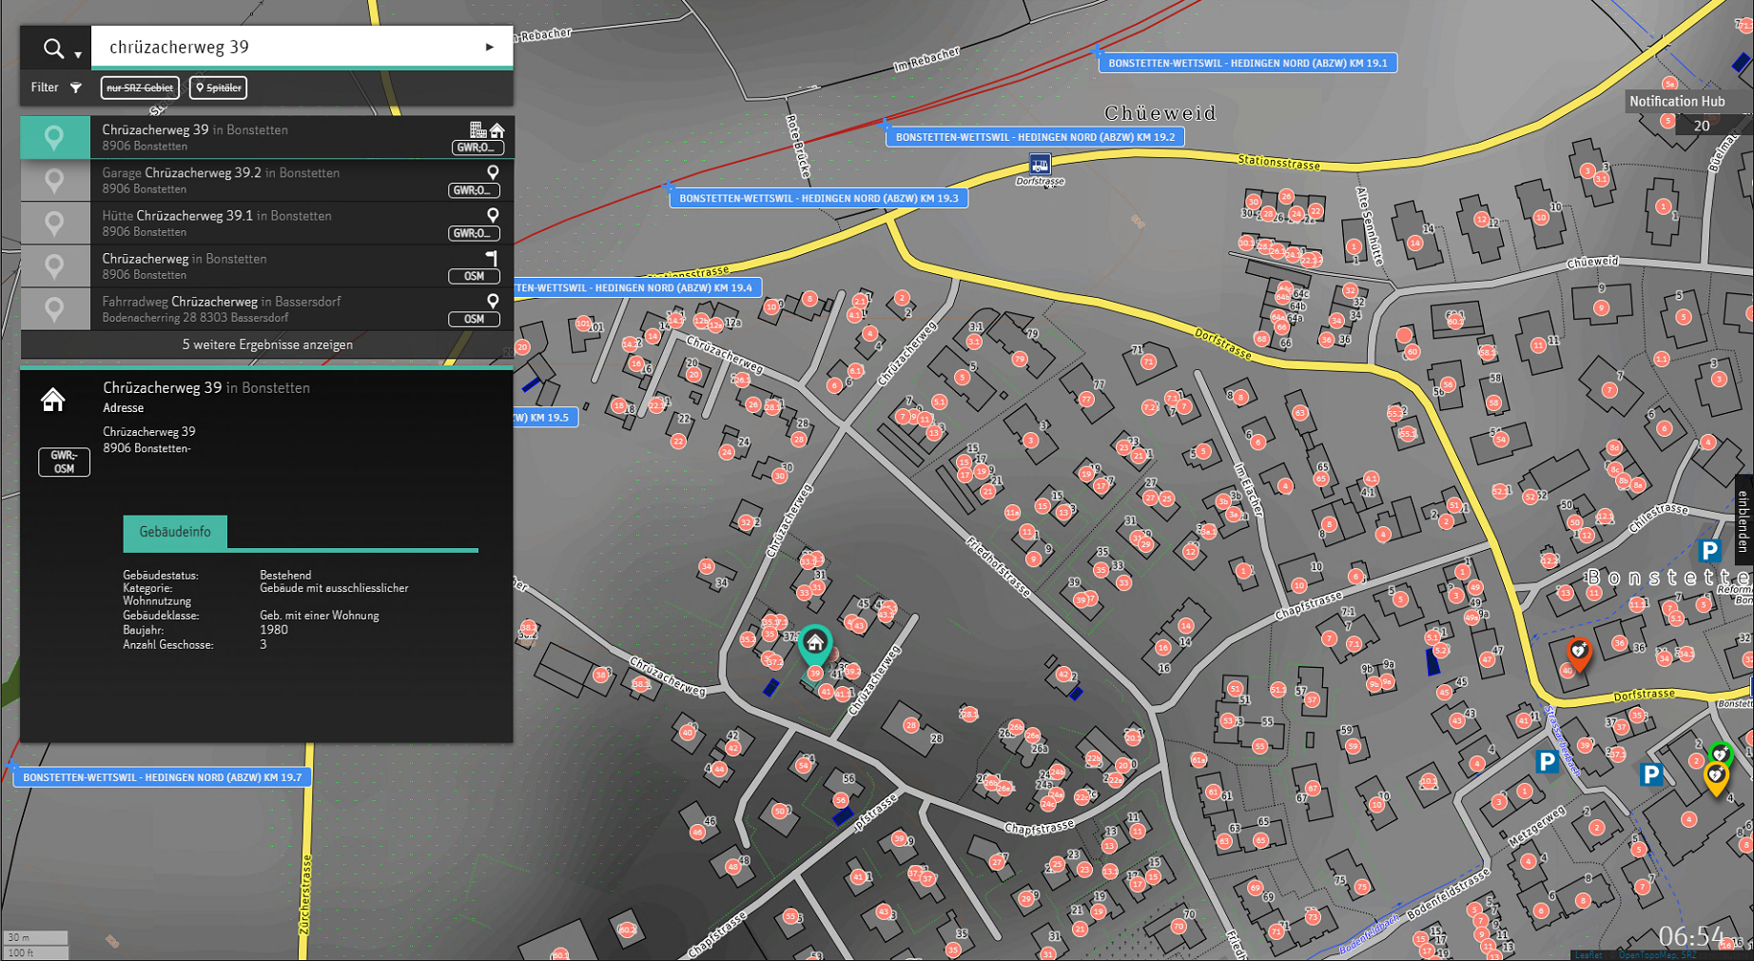
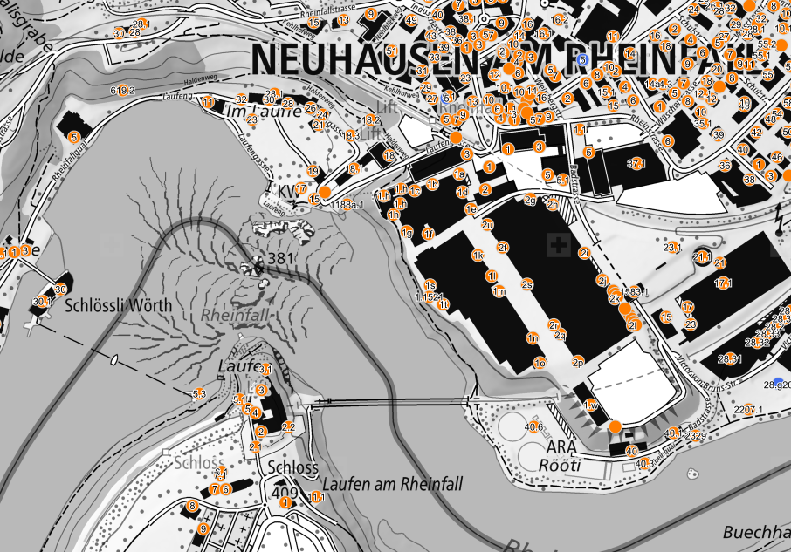
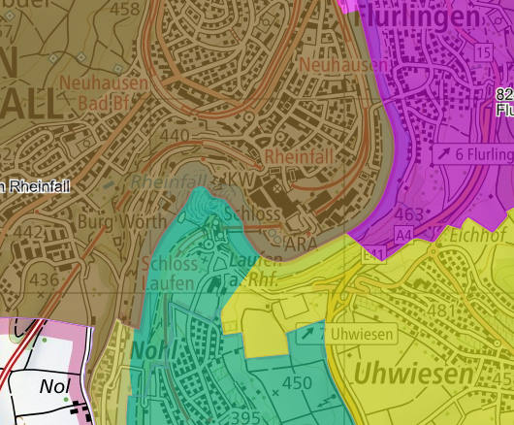
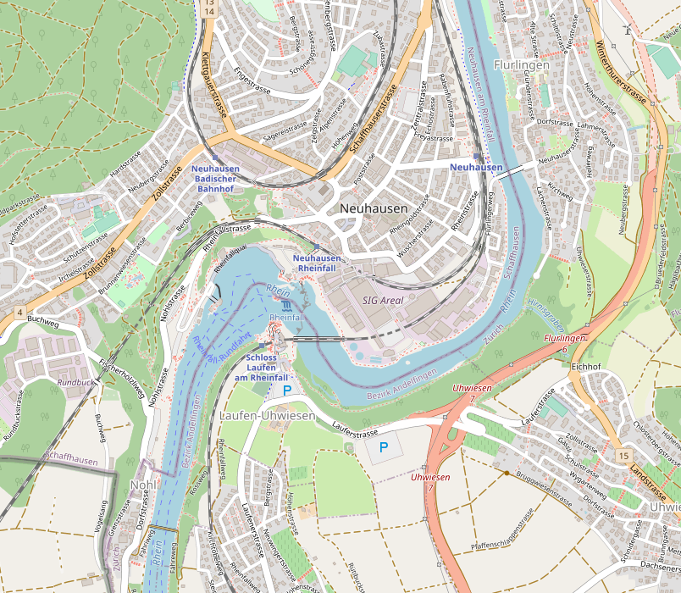
Where is your location?
Rapid localisation is important

Slide 14
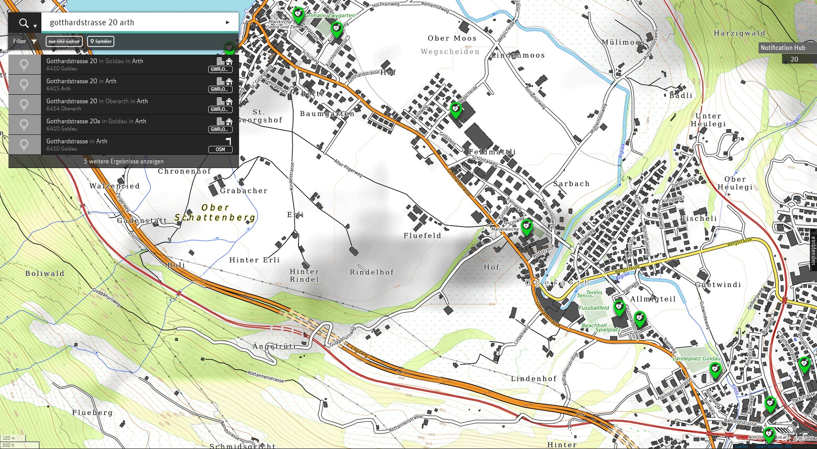
Nearly the same, but…

Slide 15
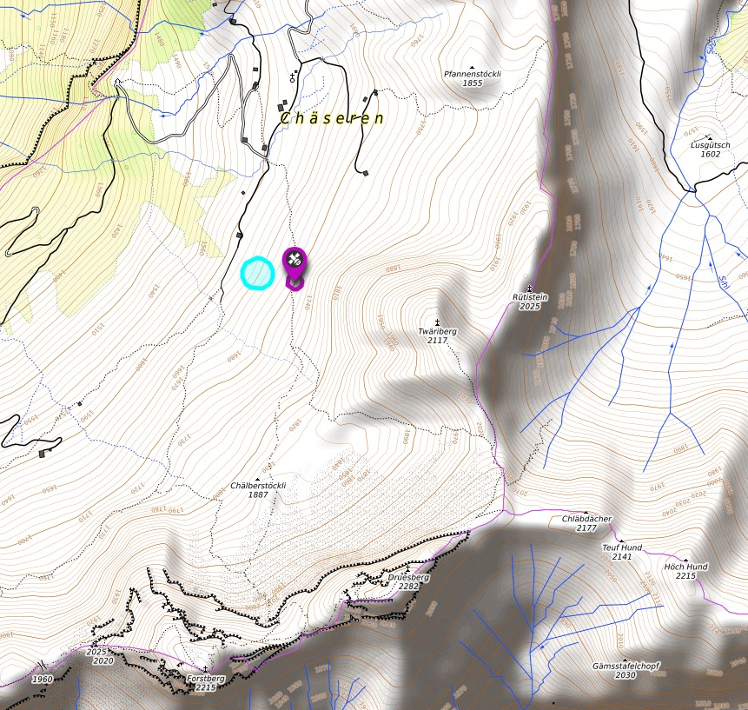
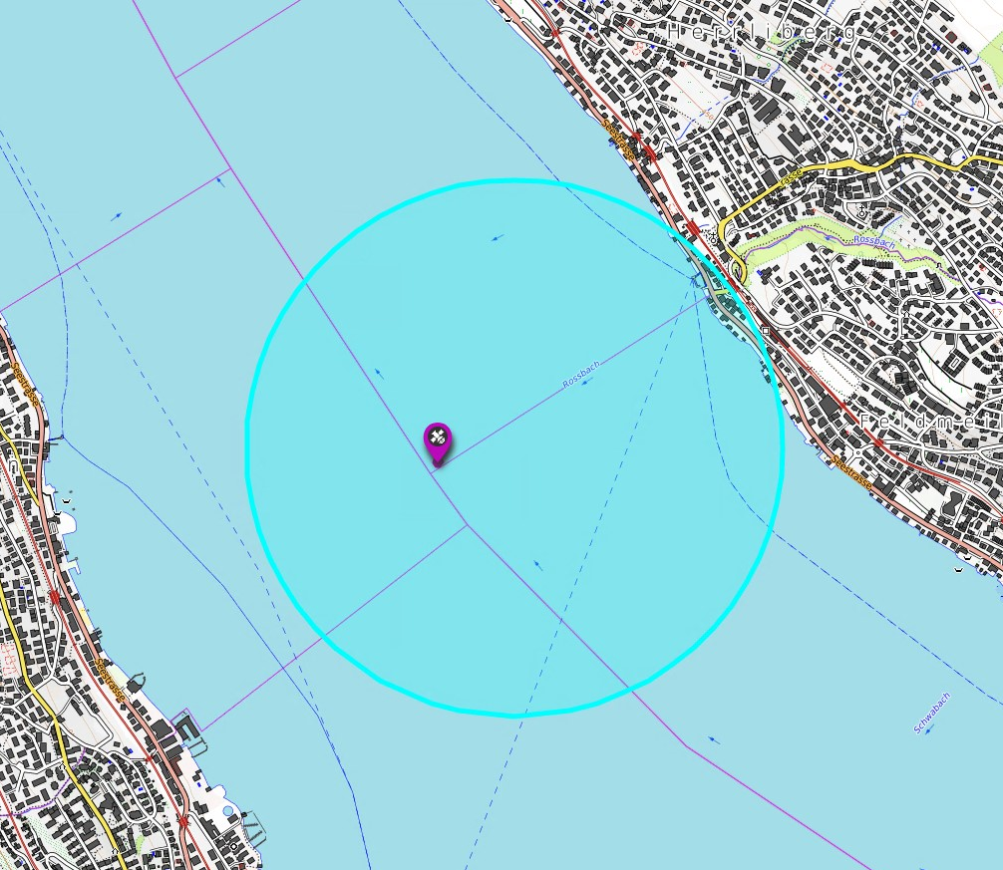
"Advanced Mobile Location" (AML) I
In the mountains and on the lakes
Notes:
Introduction
Technically well solvable, one interface
Long lead time, development/testing together with primary care provider
Introduced without extensive training, worked well

Slide 16
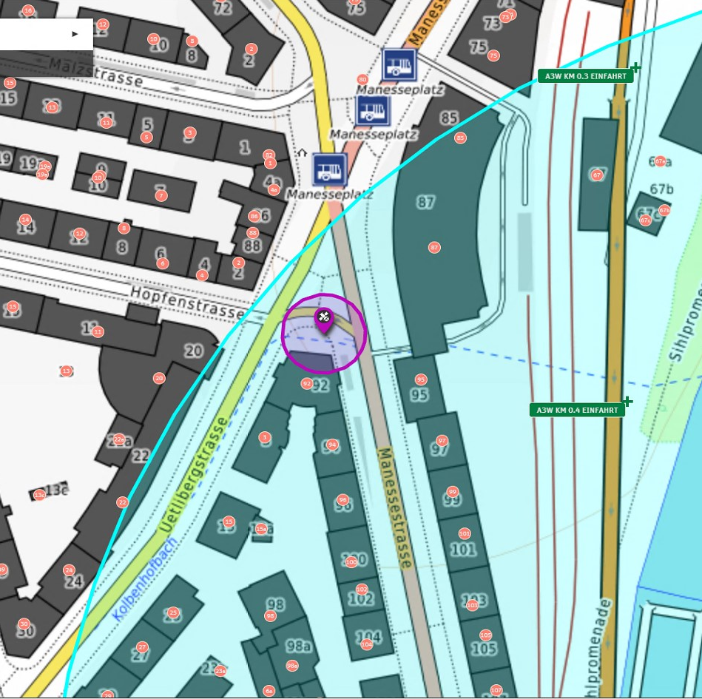
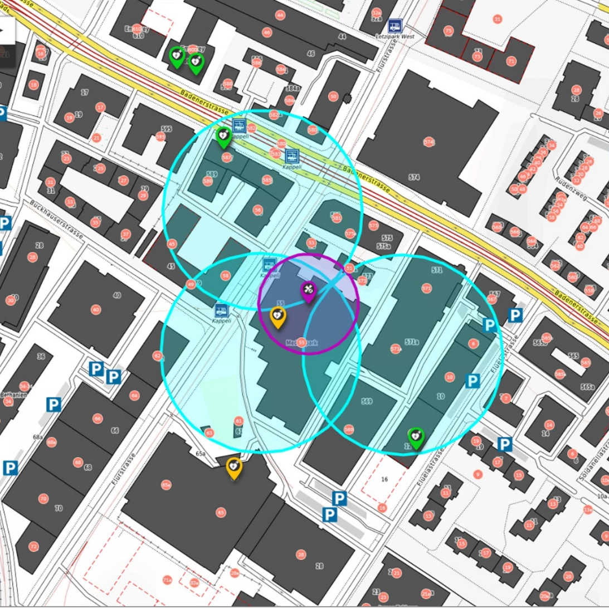
"Advanced Mobile Location" (AML) II
Works in urban areas as well
Notes:
Introduction
Colour changed from yellow to magenta
Quickly accepted by call takers, "The best thing we've done in recent years"

Slide 17
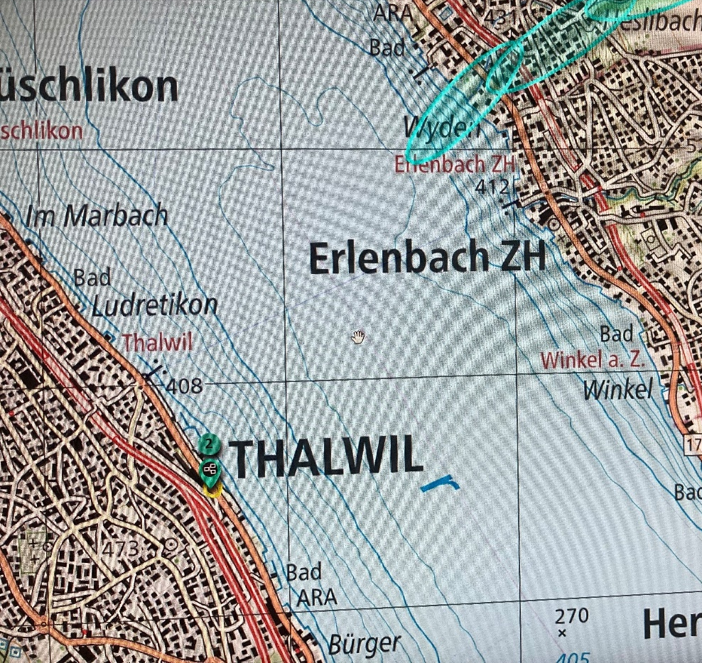
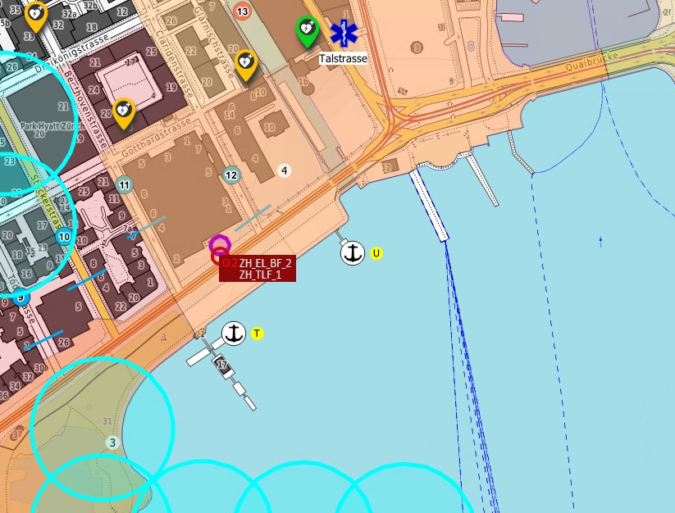
Device-based localization
Far superior to the existing triangulation method. But…
Notes:
Network and device-based localisation
Both localisation types in parallel
Network-based immediately, less accurate (light blue)
Device-based with delay, but more accurate (yellow/magenta)

Slide 18
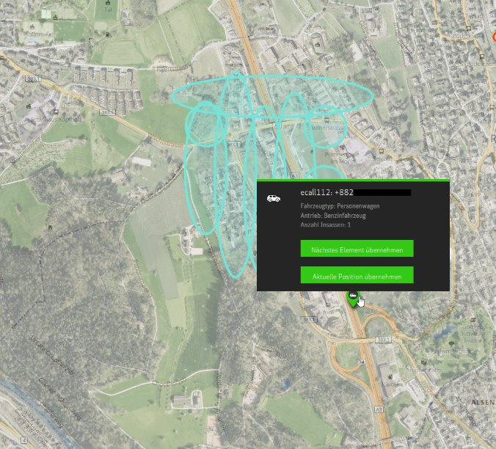
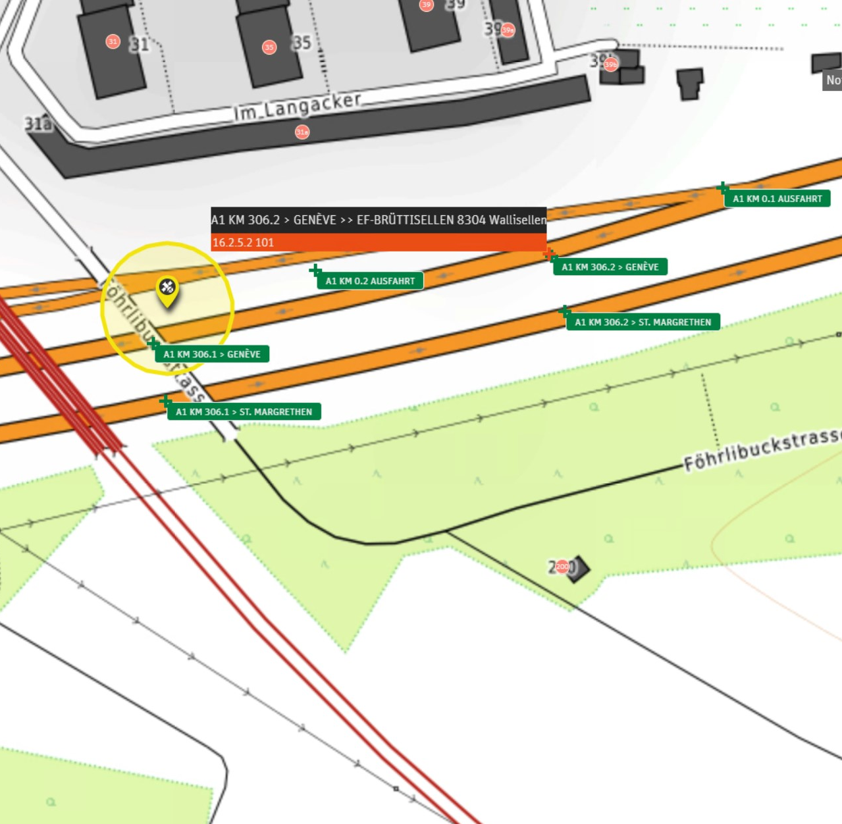
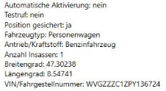
eCall112 and PSAP-transfer
Simply to work together closely
Notes:
eCall112 via police, direct enquiry even with forwarding

Slide 19

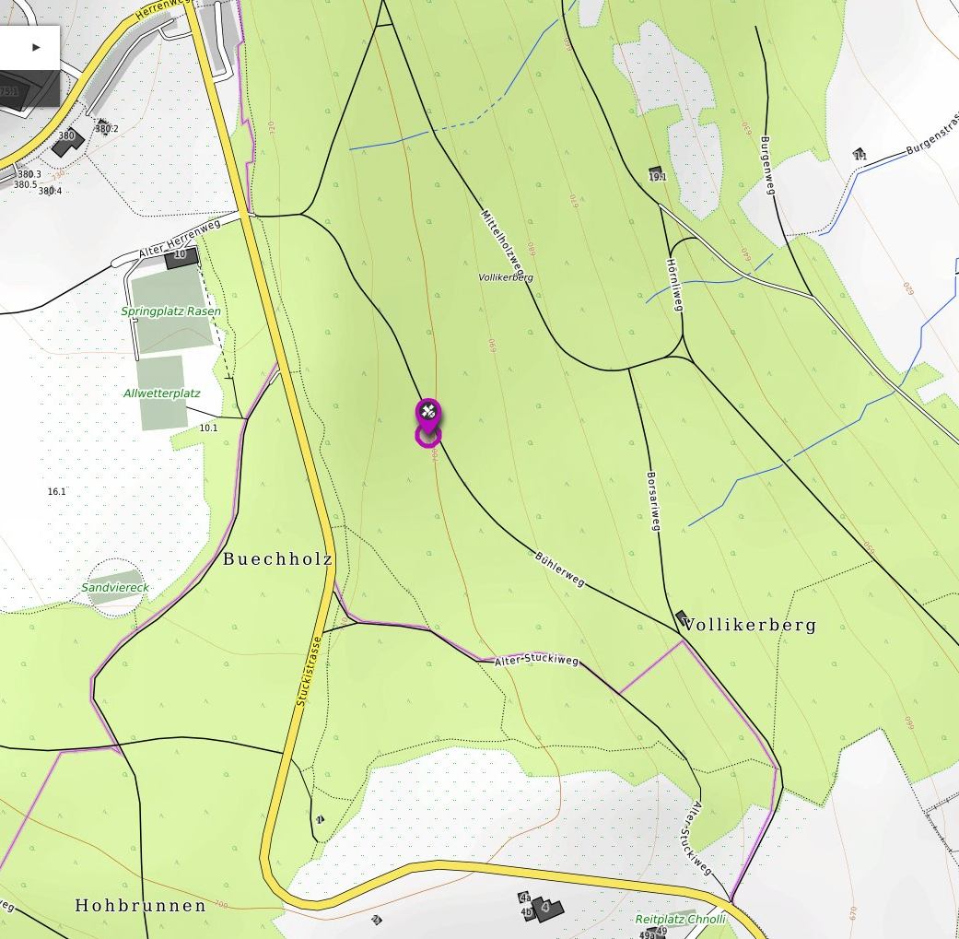
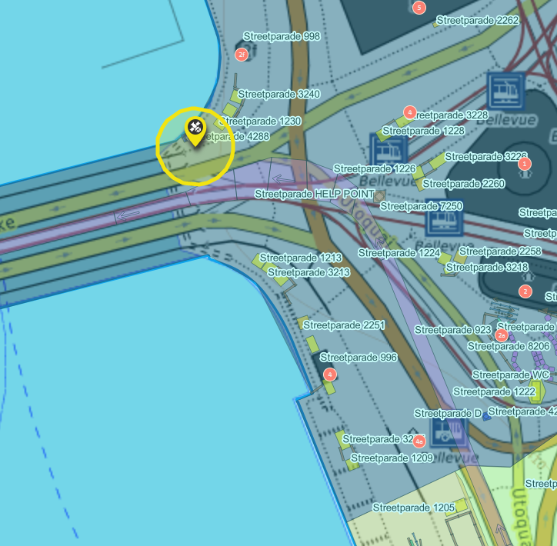
NG112-CH is easy implemented
Challenges to utilise the new opportunities more efficiently
Notes:
Challenges
Fixing the address
Create a location where the emergency site actually is
Emergency services no longer only work with "text", map section is also included --> app etc.
Change in thinking
Example Streetparade

Slide 20
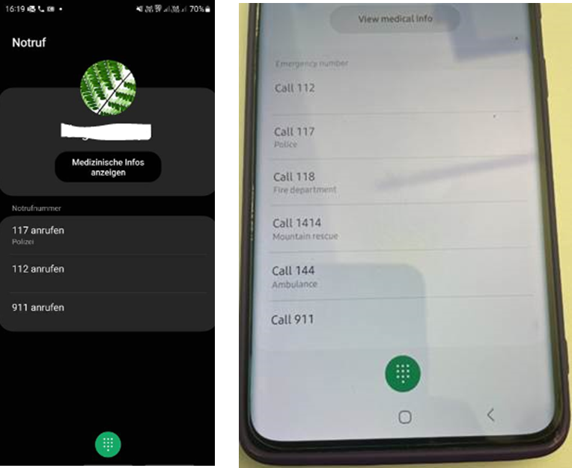
5.1 End devices - IoT / OTT
End device software
  Impact:
  Increased number of unintentional emergency calls to PSAP
  Number of emergency calls Example "Pocket Calls":
  Normal number of emergency calls: 12-13k emergency calls/day
  Number of emergency calls May 2023: 20.5k emergency calls/day
  Trigger:
  New software on mobile devices led to
  increased unintentional emergency call volumes
  (pocket calls)

Slide 21
5.1 End devices - IoT / OTT
What is needed from the PSAP's perspective?
  Binding international standards
  Telecommunications regulatory requirements
  Clear SLA with all parties involved (MNO, PSAP, device manufacturers / software suppliers)
  Control and consequences of non-compliance with the requirements

Slide 22

5.2 Barrier-free communication
Consultation of all parties involved necessary before technical solution
  Tasks are special & complex:
  Specialised support
  Special websites
  Special solution
  Special routings
  Special process for PSAP
  Translator availability

Slide 23
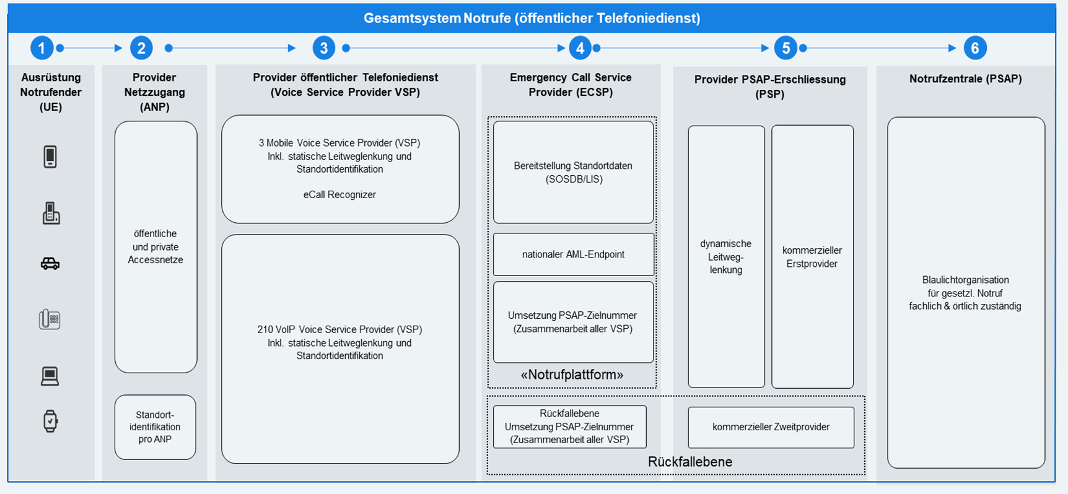
5.3 Reference model CH
Actors of the overall network
  Emergency callers OS & HW suppliers of end devices
  Network infrastructure providers (AMP) Telecommunications service providers (VSP) / Mobile network licence holders (MNO)
  Universal service licence holder Emergency call centre VSP
  Emergency call centres (PSAP).

Slide 24

5.4 Switching off 2G/3G - emergency calls via 4G/5G and commuters
Effects
  Initial situation:
  Emergency calls should be possible across the board via all available mobile networks
  Challenges:
  Unauthenticated emergency roaming 4G
  Device behaviour in 4G/5G (for instance: IOS12 or similar)
  Old end devices / modem
  NG eCall 112
  Communication with the population

Slide 25
