Slide 1
New Command Units
Abdel Guermellou 24/09/2024

Slide 2
Background
The CURP started in March 2017
Aimed to be a one stop solution
Split into two procurement streams 2019
LFB ICT procured new incident command operating system 2022
CU’s going live 2023

Slide 3
Command Units
Consultation over six months, with all personnel CU to Commissioner
Consultation steered the requirements for the new vehicles
Tender process completed February 2021
Contract award April 2021.

Slide 4
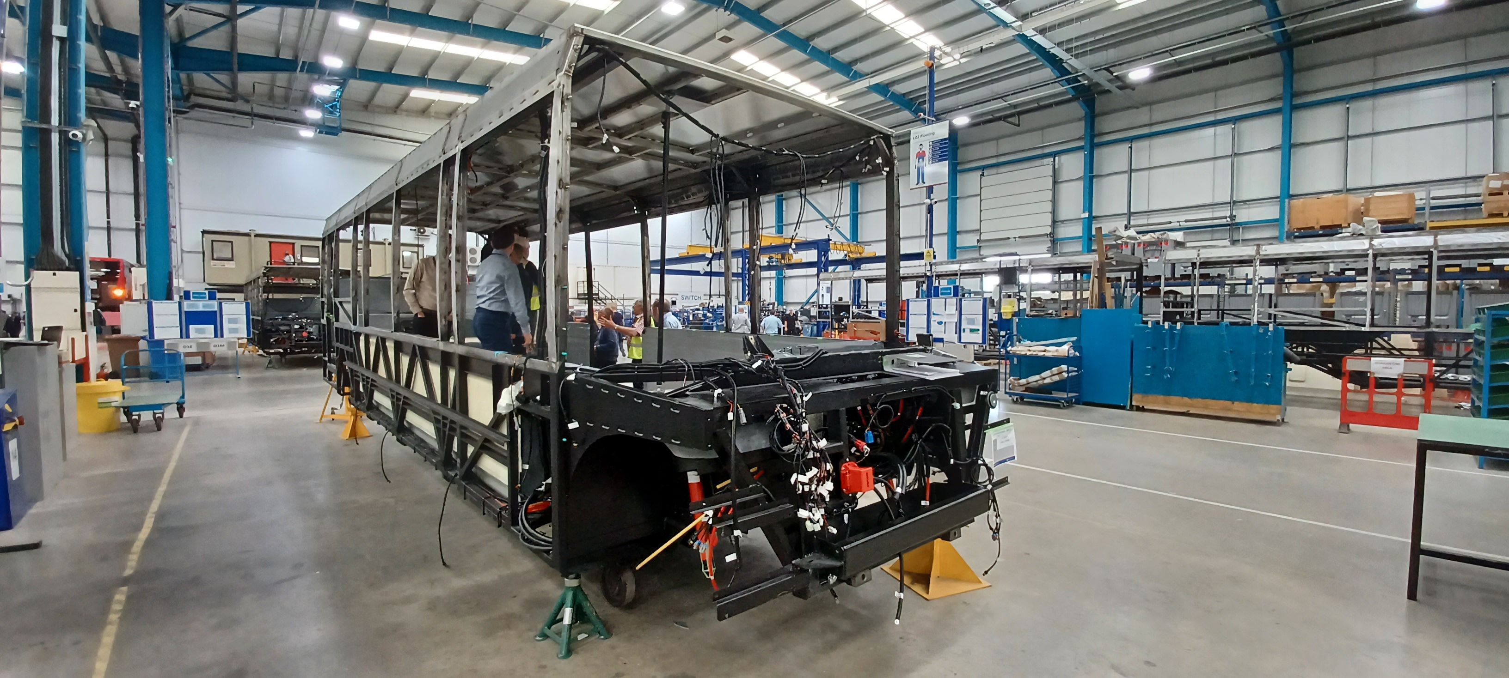
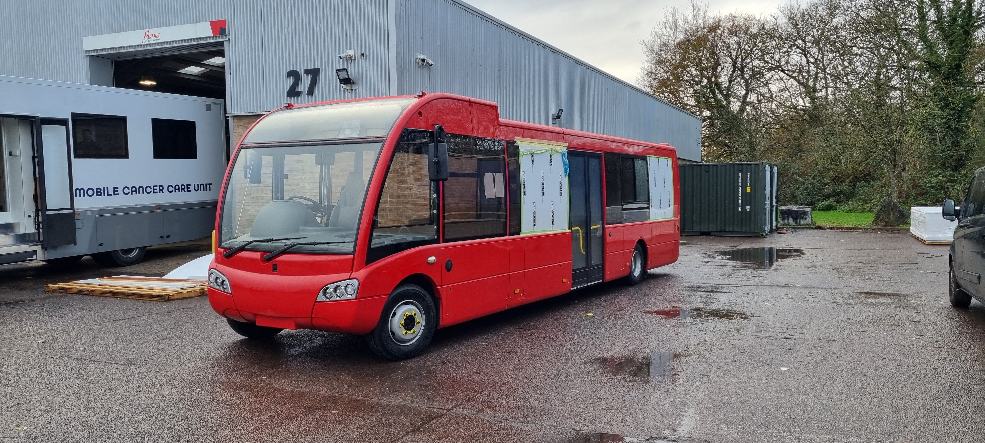
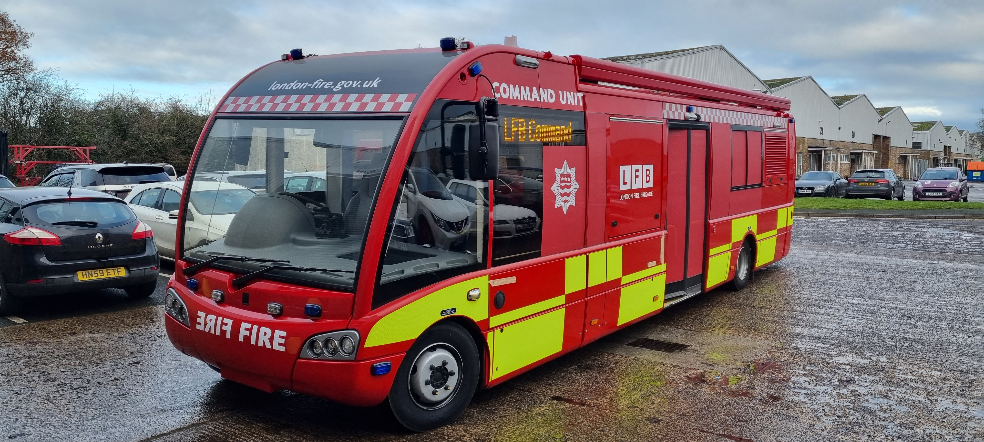
CU Build and Conversion

Slide 5
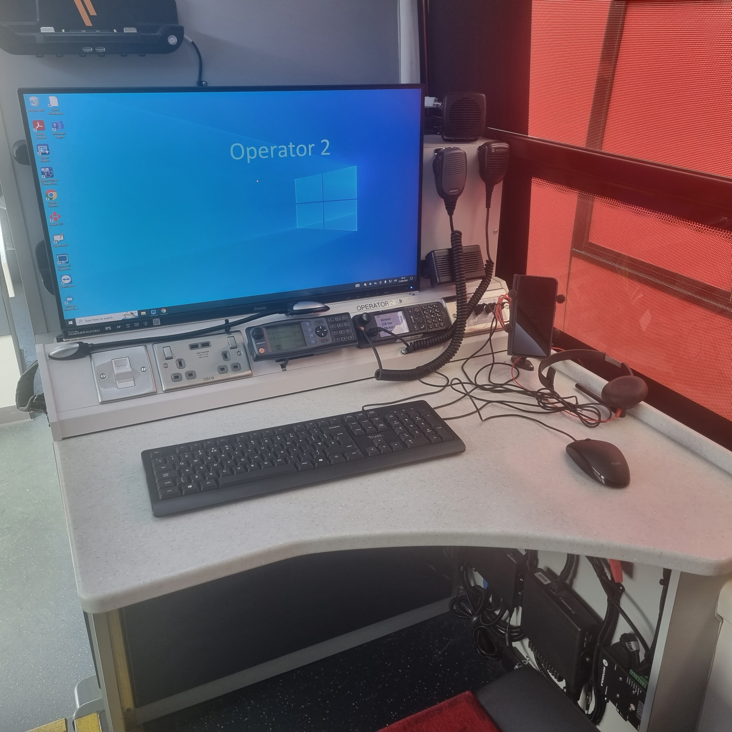
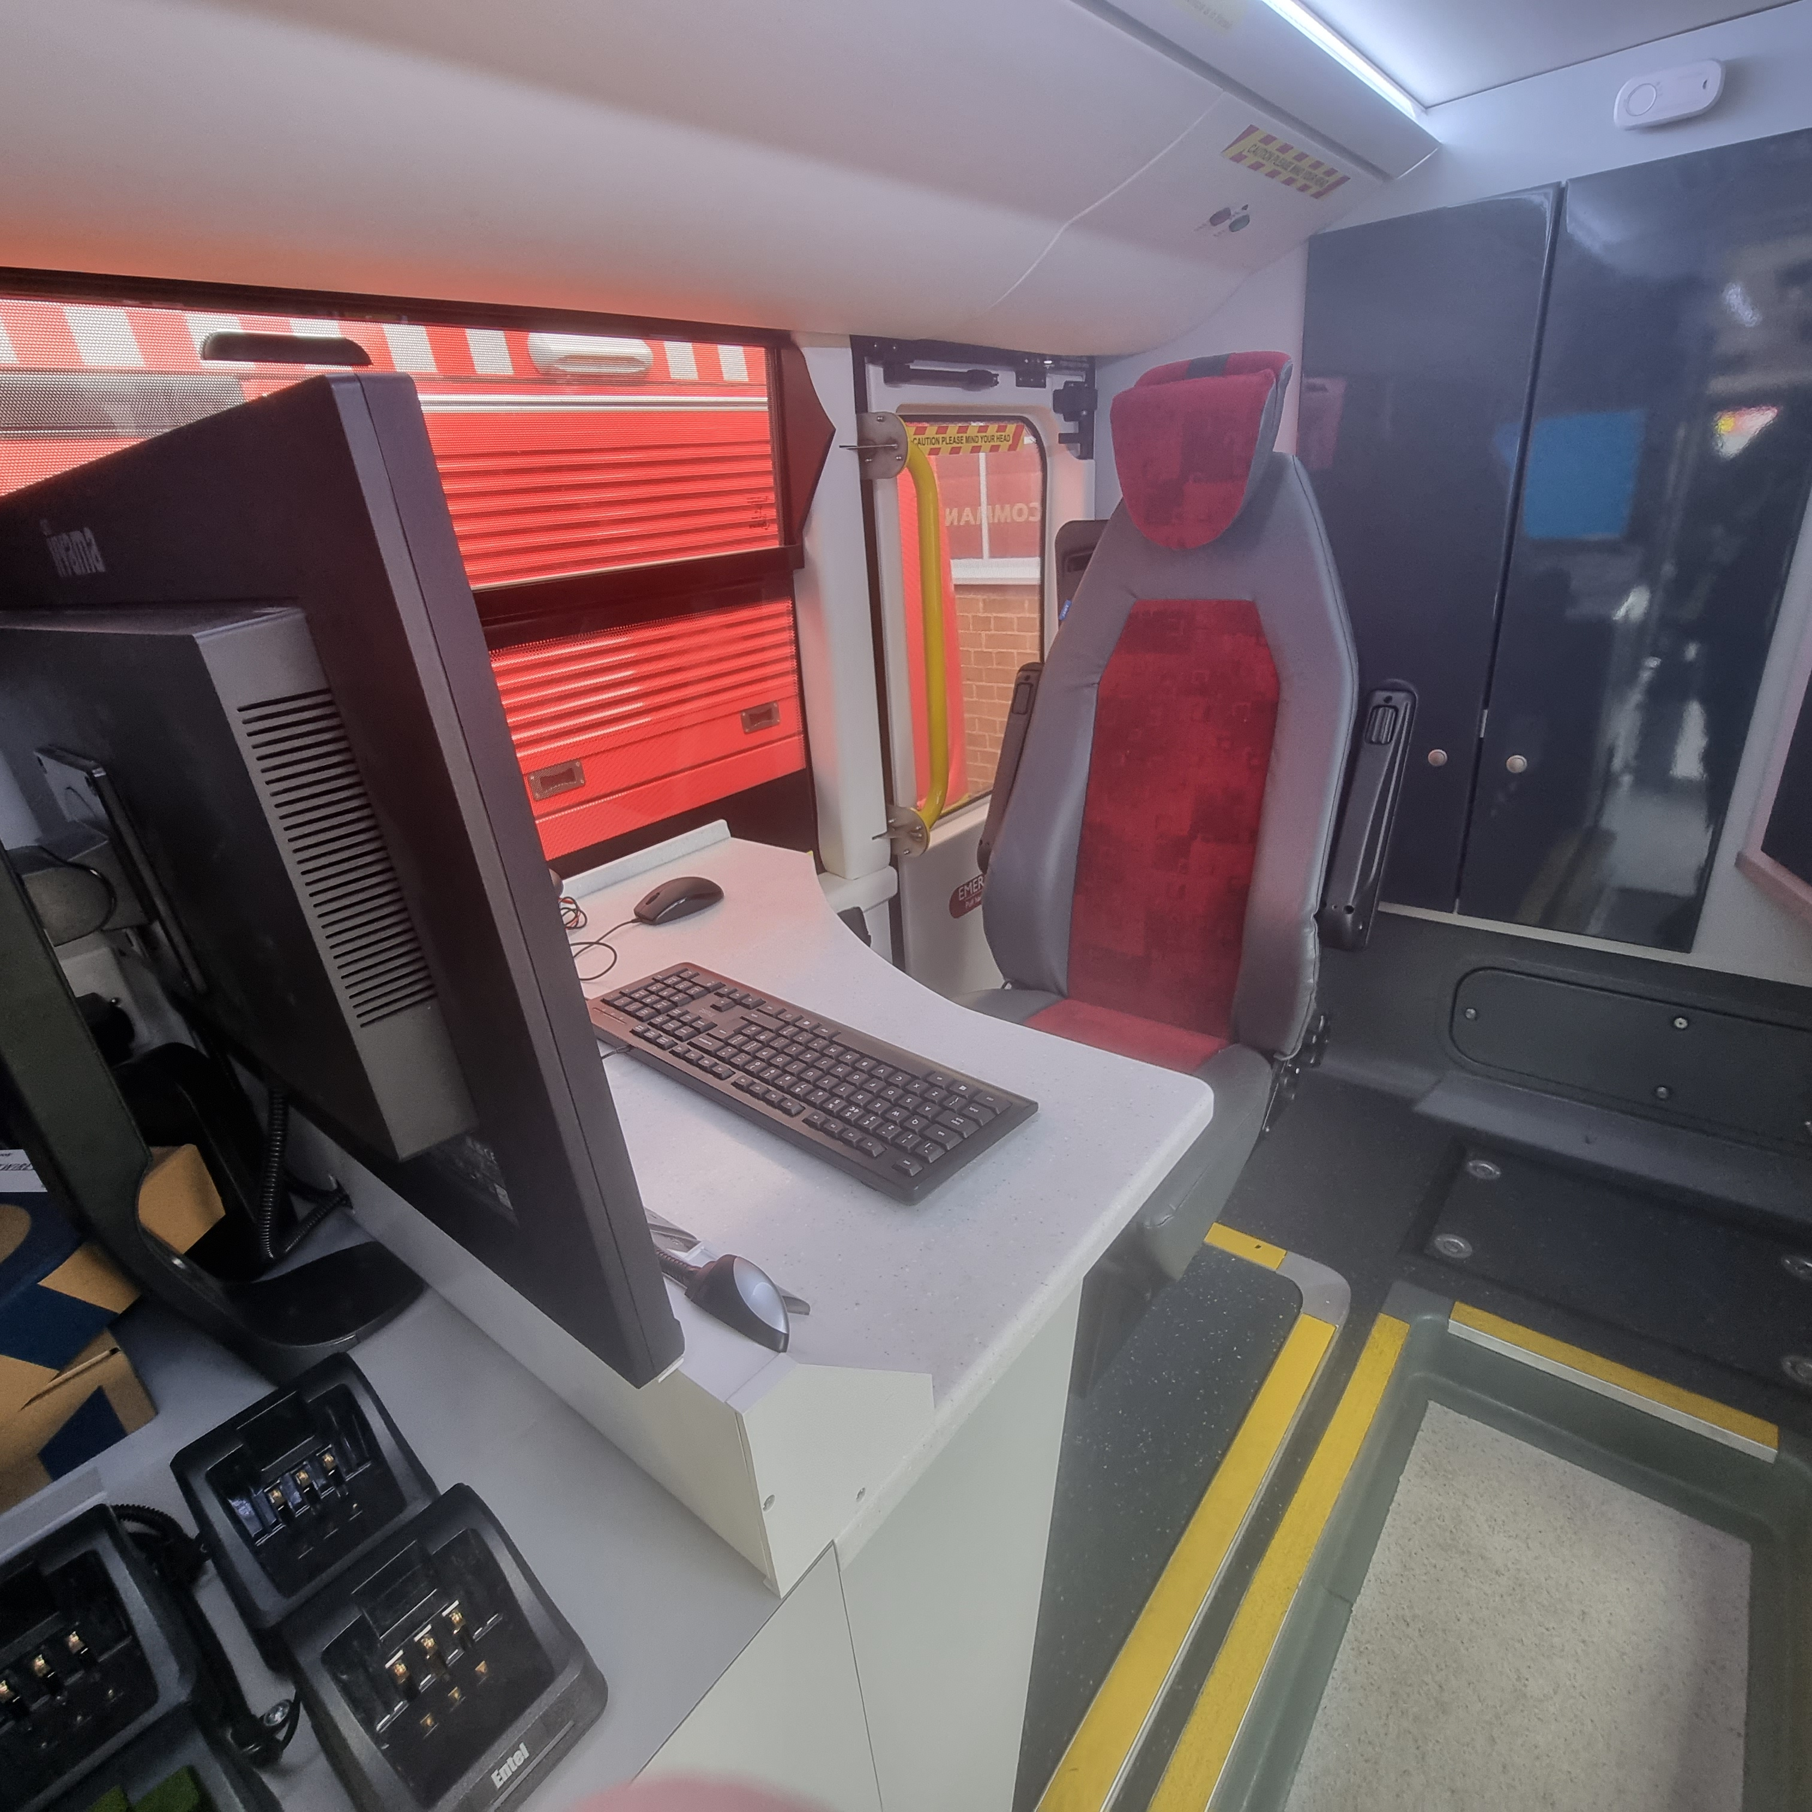
CU Build and Conversion

Slide 6
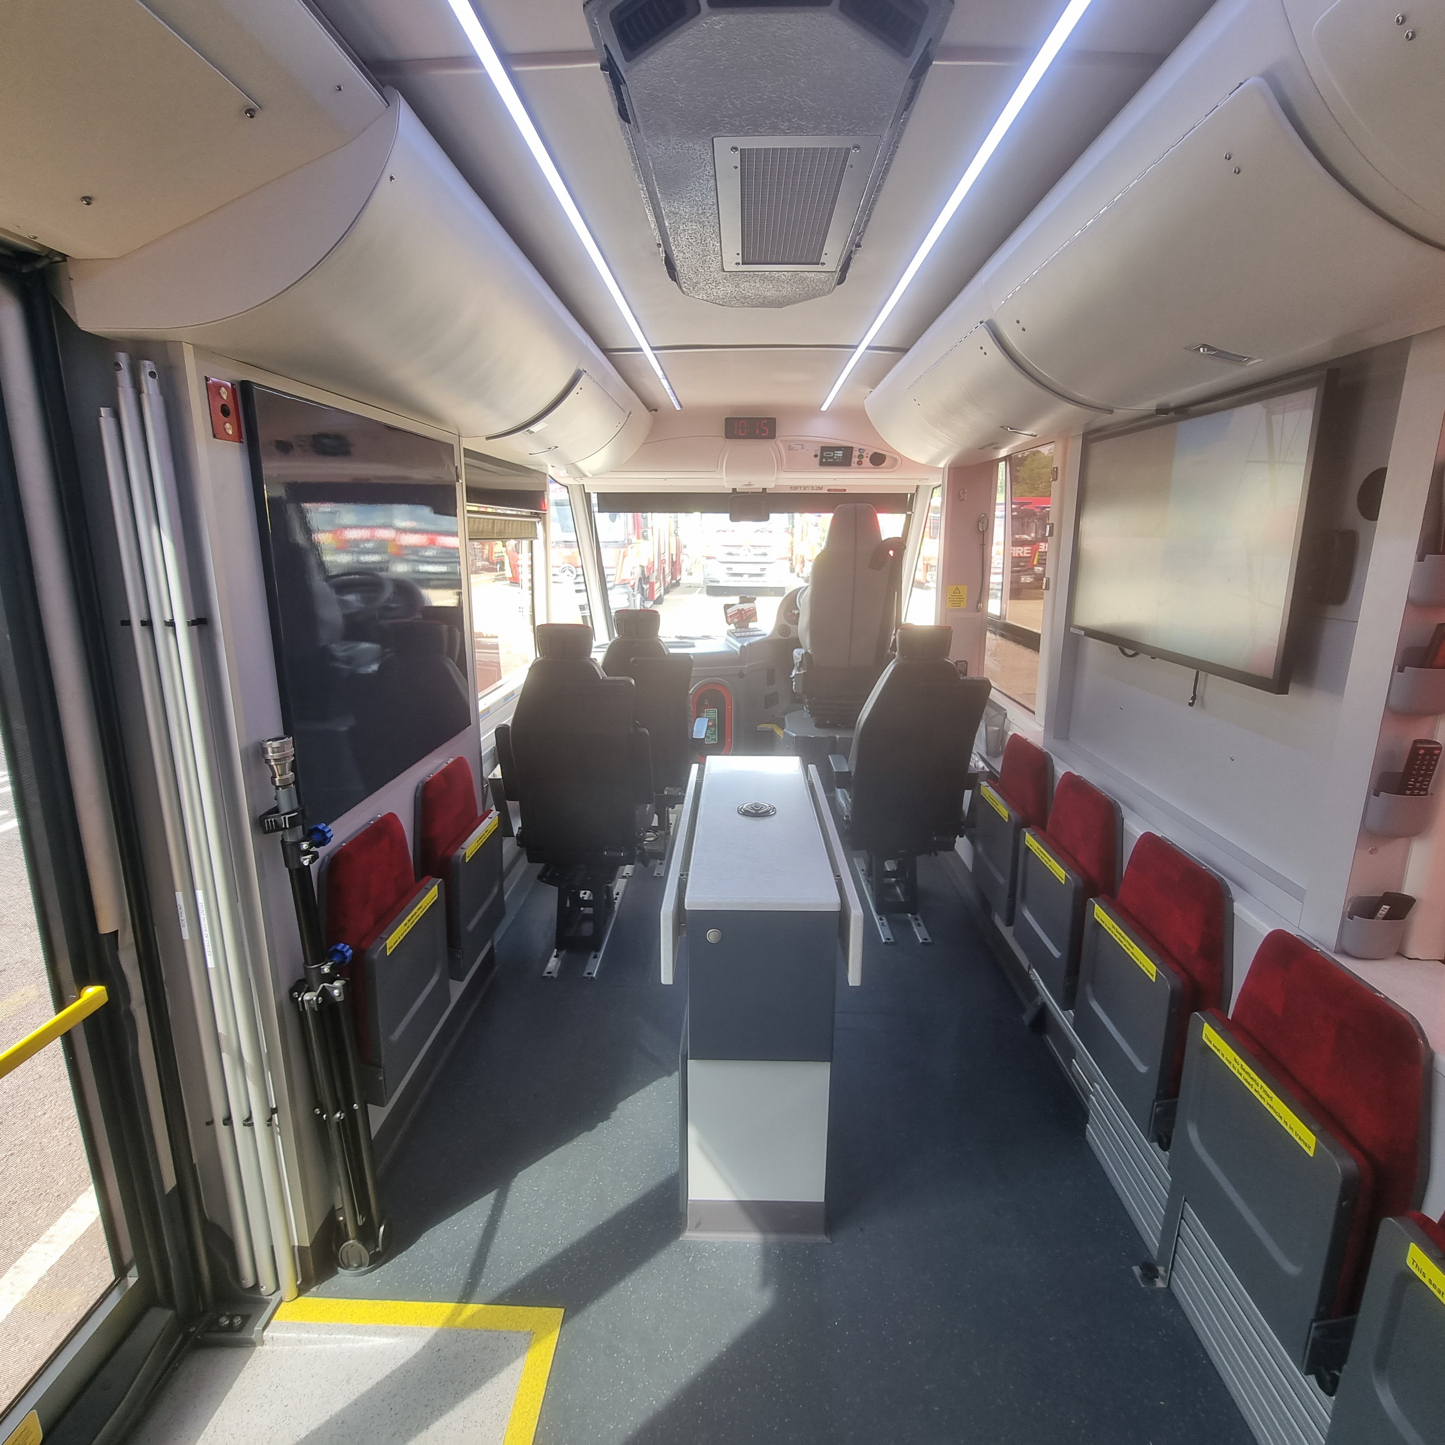
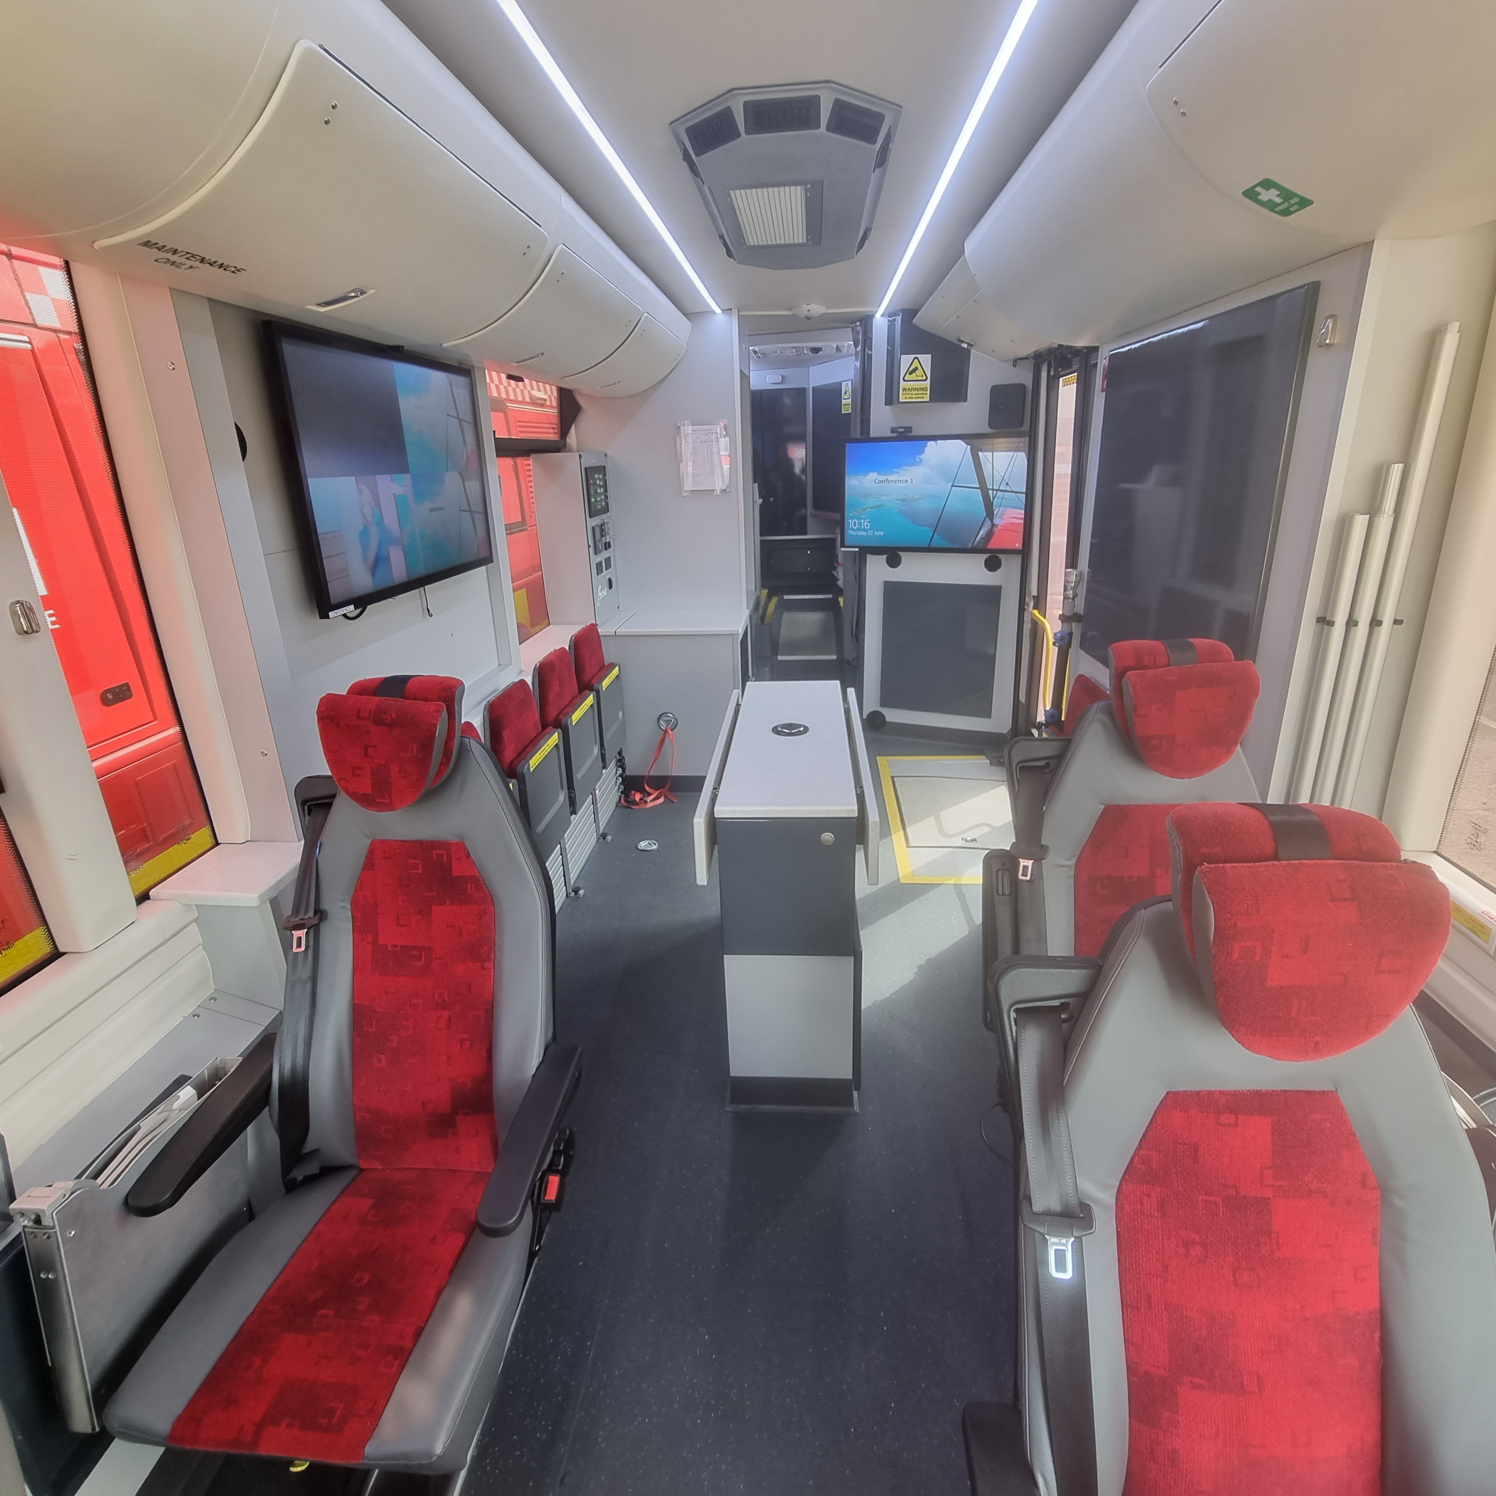
CU Build and Conversion

Slide 7
CU Capabilities
Dedicated operator and conferencing areas
Deployable cameras – one per command unit
Mast mounted optical and thermal camera
5G internet connection (Dual sim cards)
Generator starts at 50% battery life (approx. 4 hours running) Variable speed
Multiple radios – three fixed Airwave, two incident ground and two fixed repeater radios
MS teams through Office.com for conferencing

Slide 8
CU Capabilities
Access to Citrix
IRIS – Incident Command Operating System
Recording system within the conferencing area.

Slide 9
Command Unit Training
FF MDs only, four per watch per CU location (112 in total)
One-day command unit driver handling followed by a two-day driving and blue light runs
Command unit operator familiarisation, two days per watch.
CU Operator familiarisation and rollout dates on next slide.

Slide 10
Change management
Engaging Stakeholders - Methods used to engage internal stakeholders (meetings, training, workshops).
End-user involvement throughout the process.
Internal communications and support mechanisms.

Slide 11
Q&A
IRIS Input to follow

