Slide 1
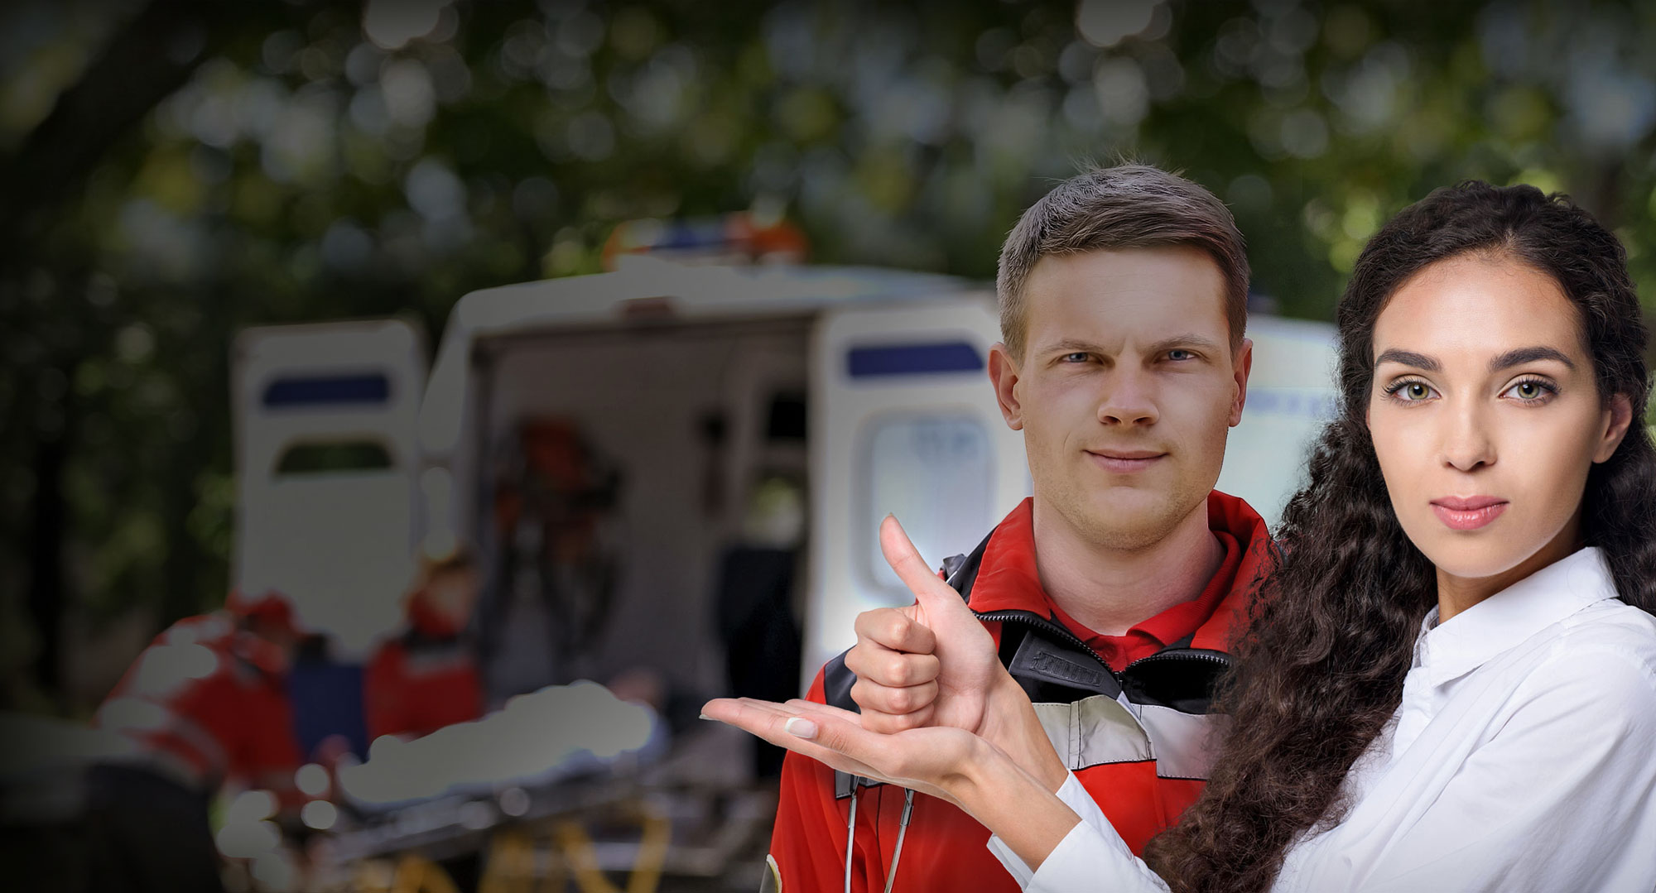
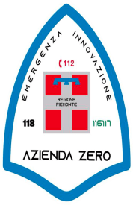
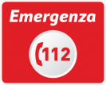
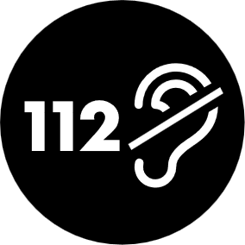
112 Sordi 112 Service for the deaf
THE ITALIAN EXPERIENCE, THE EMERGENCY MOBILE LINK and
FUTURE SCENARIOS of ASSESSMENT PROTOCOLS

Slide 2
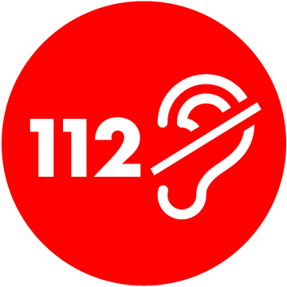


WHAT IS 112 SORDI?
112Sordi is the Italian national emergency service for deaf people.
Provided by the 800 800 112 number and supported by the 112 emergency service.
The service notifies to 112 operators when the caller is deaf, to let them give adequate support.

Slide 3


112 SORDI
By means of a telephone call, any citizen (Italian or foreign) present on national territory and equipped with a mobile device can communicate with the emergency services
by calling the dedicated number.
482 CALLS MANAGED 112 SORDI
0,02% TOTAL NUMBER OF CALLS IN 2023
NUE 1.1.2. The single number for all national emergency calls
ENS National Council for the Protection and Support of the Deaf and Hard of Hearing
MINISTERO Ministry of the Interior and Ministry of the Economy and Made in Italy

Slide 4

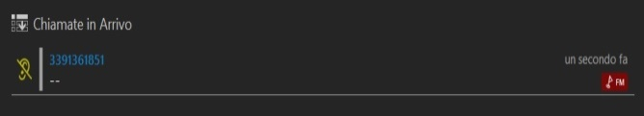
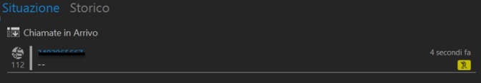


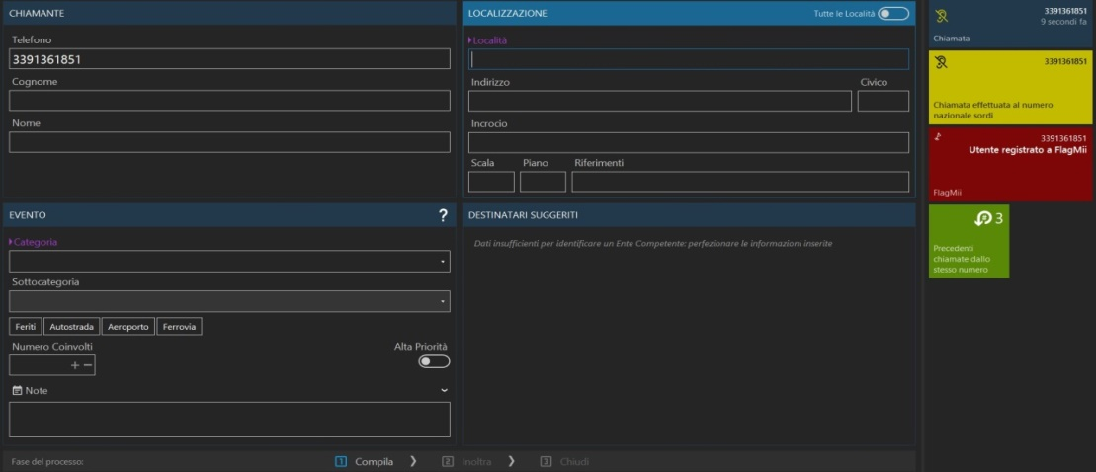
CLASSIFYING CALLS FROM DEAF USERS
symbol identifying ‘’incoming calls‘’
CALL FROM
TOLL-FREE NUMBER
REGISTERED TO PORTALE SORDI
Number in the archive
of the National Deaf Portal
popup information of the call from a probable deaf user

Slide 5


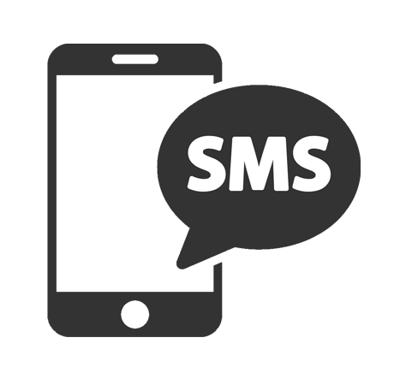
112SORDI'S APP-FREE SOLUTION
is based on SMS that activate the service with just 1 click!
5
ALL THE CALL SUPPORT FUNCTIONS ARE ACTIVATED
TEXT CHAT
1
2
3
4
THE CALLER IS IDENTIFIED AS A DEAF CITIZEN
112 ACTIVATES THE
SERVICE
SENDS AN SMS TO THE CALLER’S SMARTPHONE
THE CITIZEN CLICKS THE LINK IN THE SMS
PICTURE-BASED ASSESSMENT PROTOCOL
VIDEO CONFERENCE
WEB-BASED technology supported by all smartphone models
GEO LOCATION
112 Sordi national web portal

Slide 6
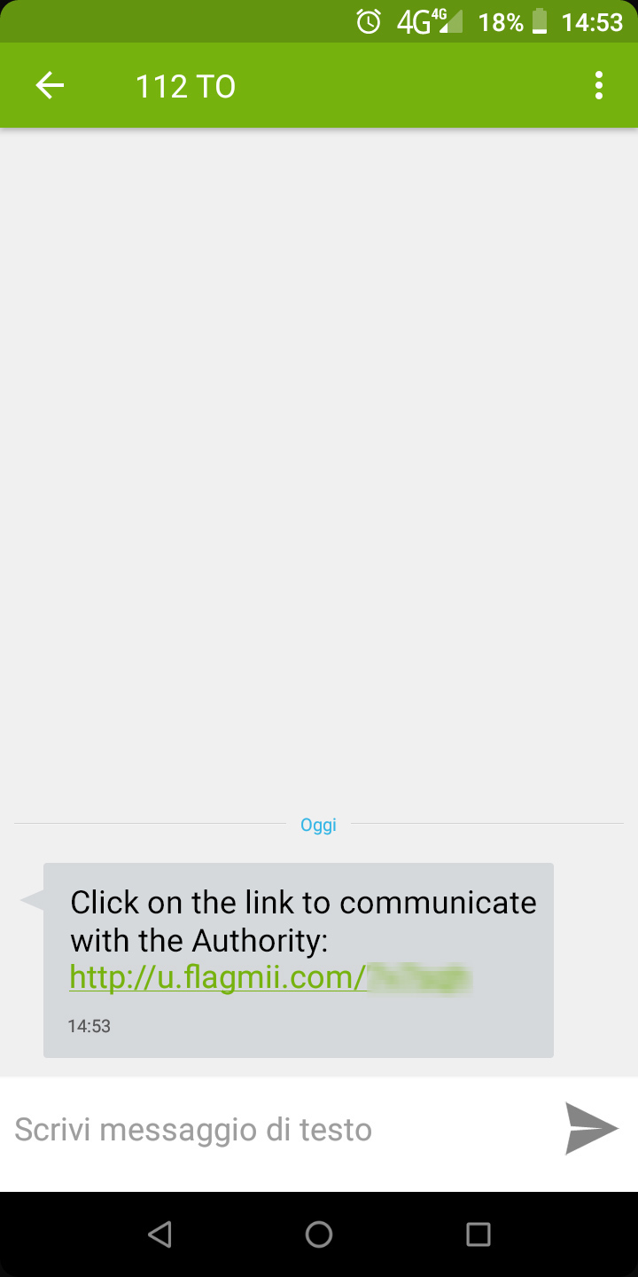
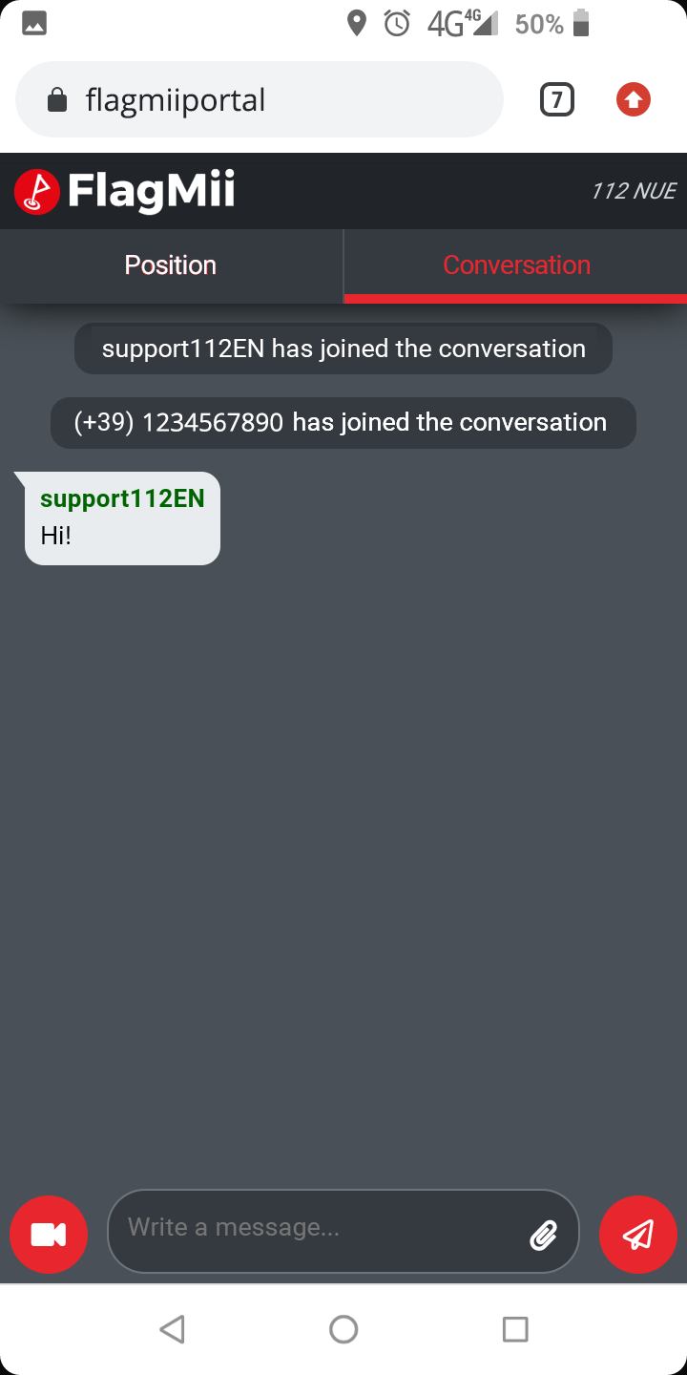
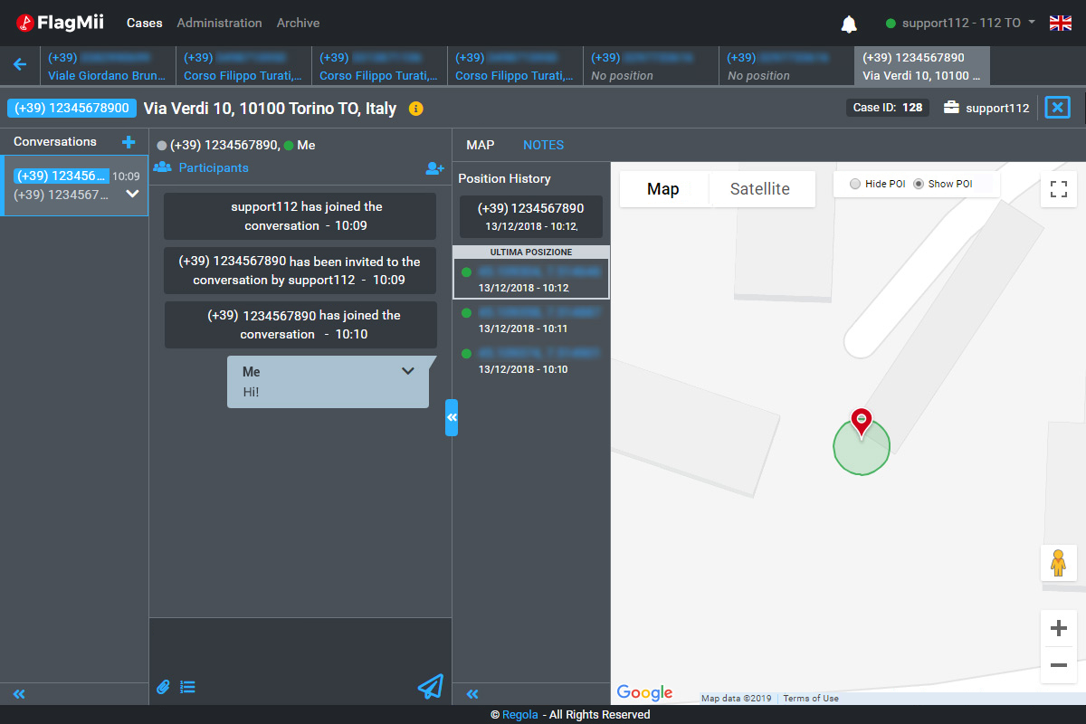
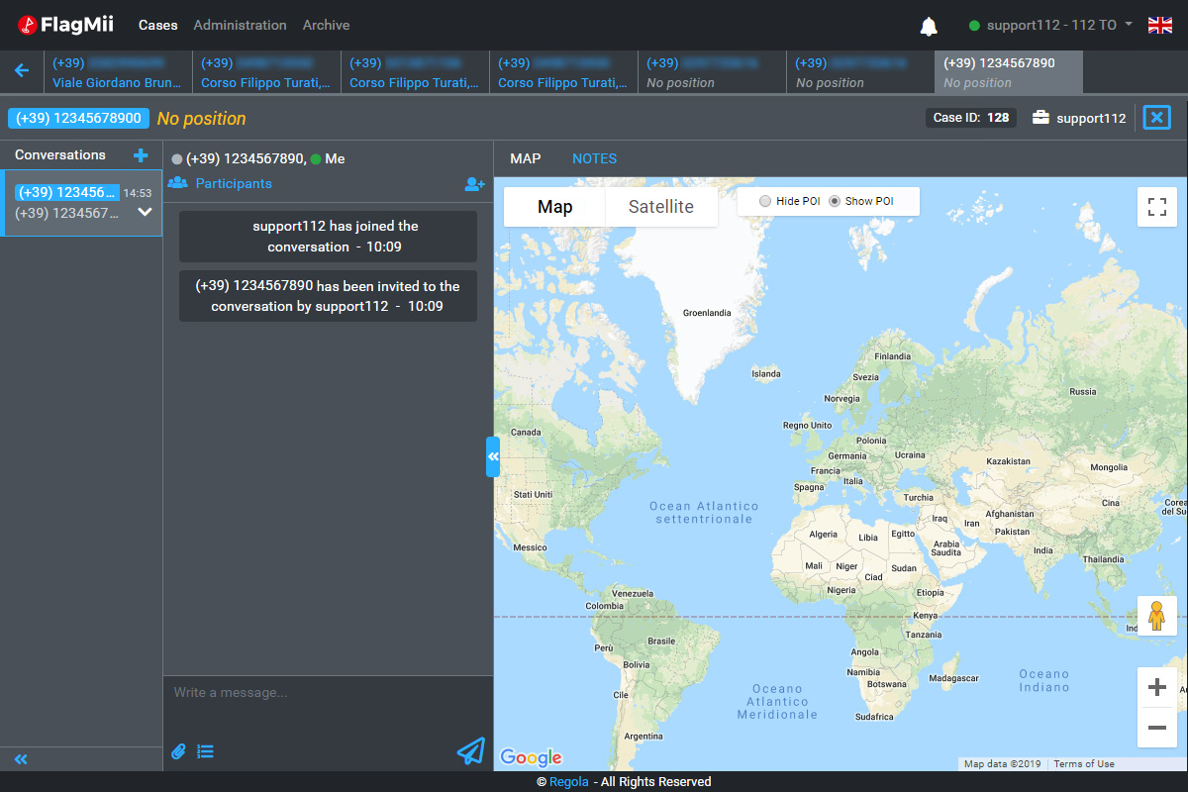

112SORDI'S APP-FREE SOLUTION
is based on SMS that activate the service with just 1 click!

Slide 7




Project start date
2023
The Project stems from a challenge launched in 2023
Search for Companies and Start-Ups to co-fund the project
state-of-the-art solutions useful for improving communication in Lis in case of emergencies or needs

Slide 8

112SORDI'S APP-FREE SOLUTION
*d/Deaf: The ‘uppercase D’Deaf is used to describe people who identify as culturally Deaf and are actively engaged with the Deaf community. Deaf with a capital D indicates a cultural identity.
«A common culture»
Supporting d/Deaf* people with Al and sign language

Slide 9

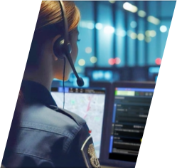
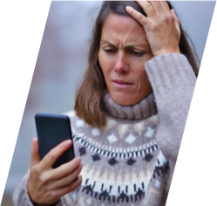
A new solution to connect
Control room
d/Deaf people
with

Slide 10

using ARTIFICIAL INTELLIGENCE
EXPERIMENTATION
Control room
with Ai
d/Deaf people

Slide 11
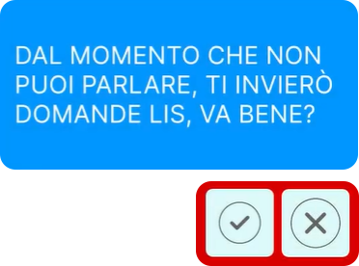
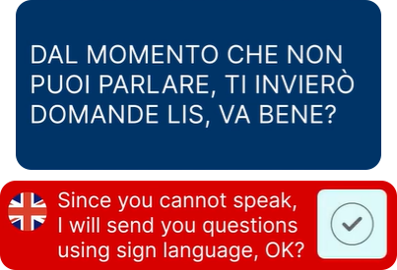


A new solution to connect

Slide 12
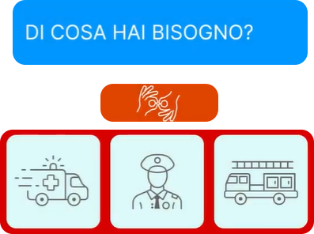
A new solution to connect
To support Sign Language, the system builds a virtual assistant that translates the questions

Slide 13
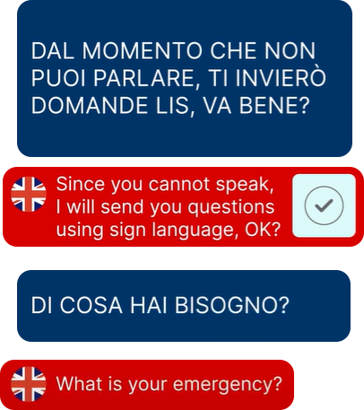
A new solution to connect

Slide 14

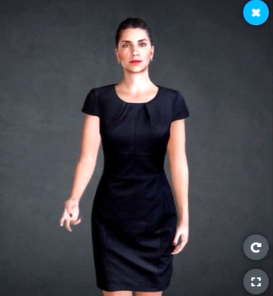
A new solution to connect
To support Sign Language, the system builds a virtual assistant that translates the questions
The process can be repeated throughout the conversation
It is possible to repeat the questions

Slide 15

A new solution to connect
Implements the goals of
Next Generation Emergency Services
NG112
NG9-1-1

Slide 16



Benefits
Increase forms of interaction between caller and control room
Reduce ambiguities and errors
Increase acessibility of emergency services

Slide 17



Service limitation
To date, the Avatar interacts through
a series of pre-defined phrases and content
Cannot yet respond autonomously
to callers (features under development)
At the moment, the avatar only recognises Italian sign language (other sign languages can be imported)
Notes:
In questo momento l’Avatar segna solamente il linguaggio dei segni Italiano.

Slide 18
thank you

