Slide 1
Enhancing Cardiac Emergency Responses with Volunteer First Responders in Europe's Rural Areas
EENA Webinar
2024-12-12
1

Slide 2
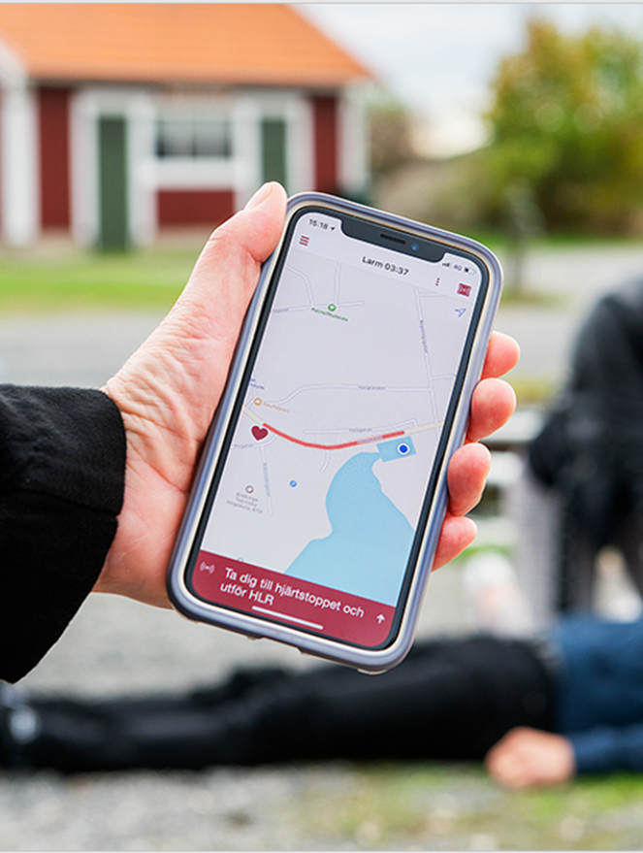
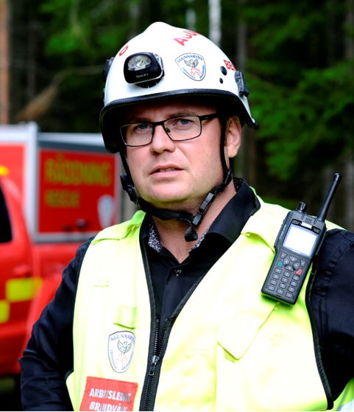
Volunteer first responders (VFR)
Emergency medical services (EMS)
Fire and rescue services (FRS)
2

Slide 3
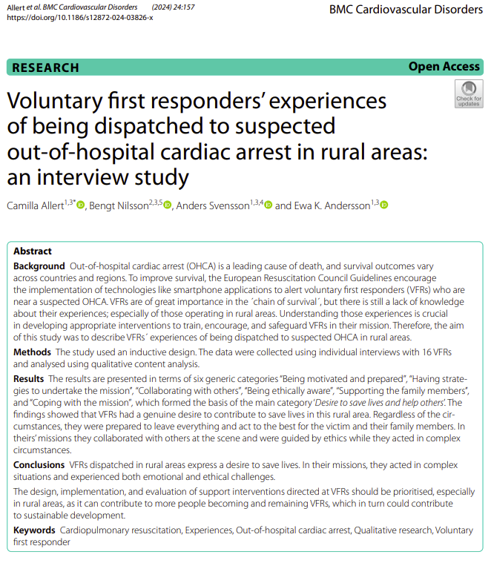
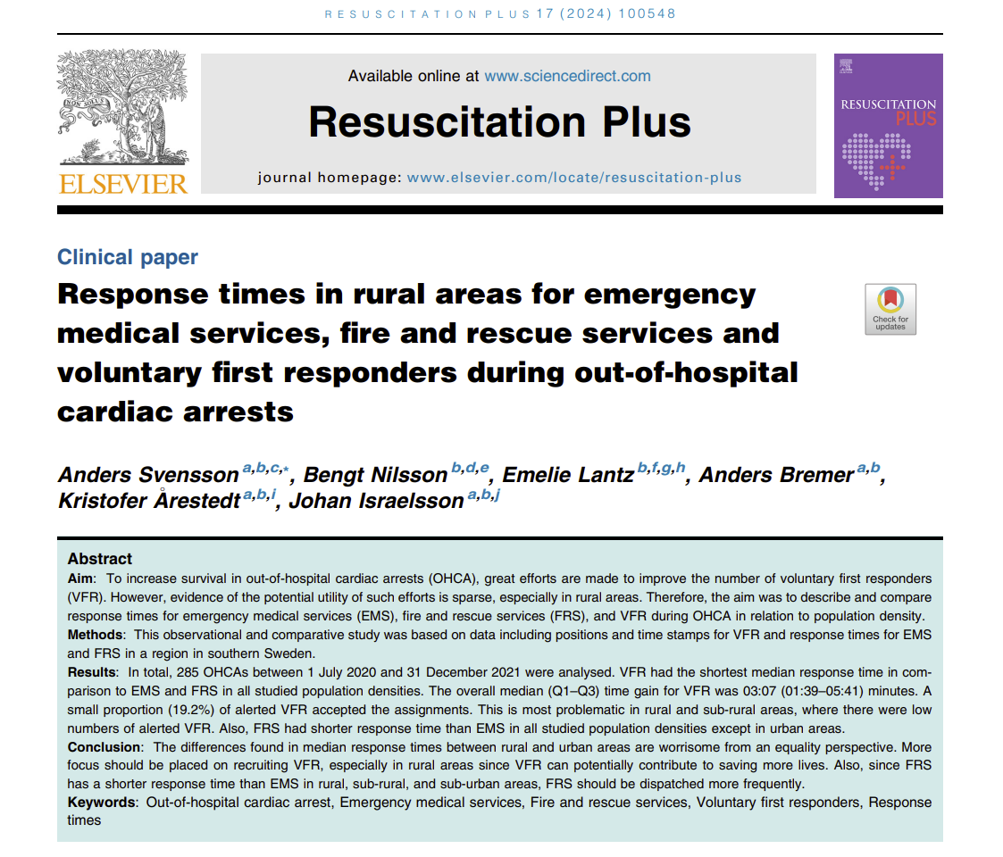
3

Slide 4
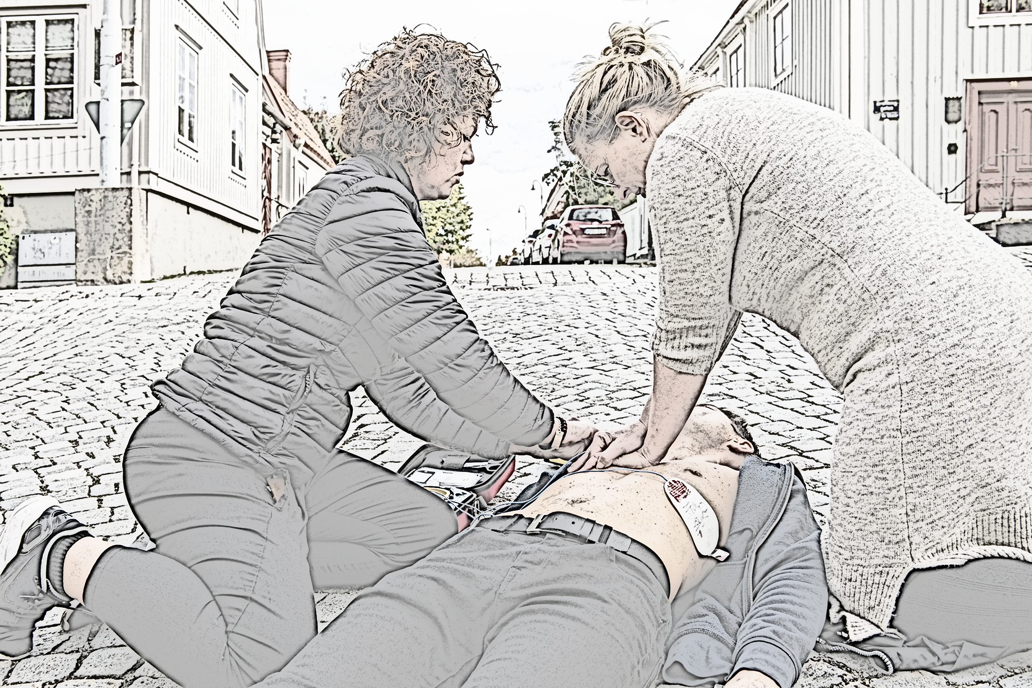
Dispatch of Volunteer First Responders to OHCA
EMCC determines whether the criteria are fulfilled – everything proceeds automatically
VFR alerted by a smartphone application to suspected OHCA (7 AM to 11 PM)
The system identified up to 40* VFR within a maximum radius of 10 000 meters linear distance
* During the study period, the system identified up to 30 (1 July 2020 to 31 May 2021) or up to 40 (1 June to 31 December 2021) VFR.
10 000 meters
4

Slide 5
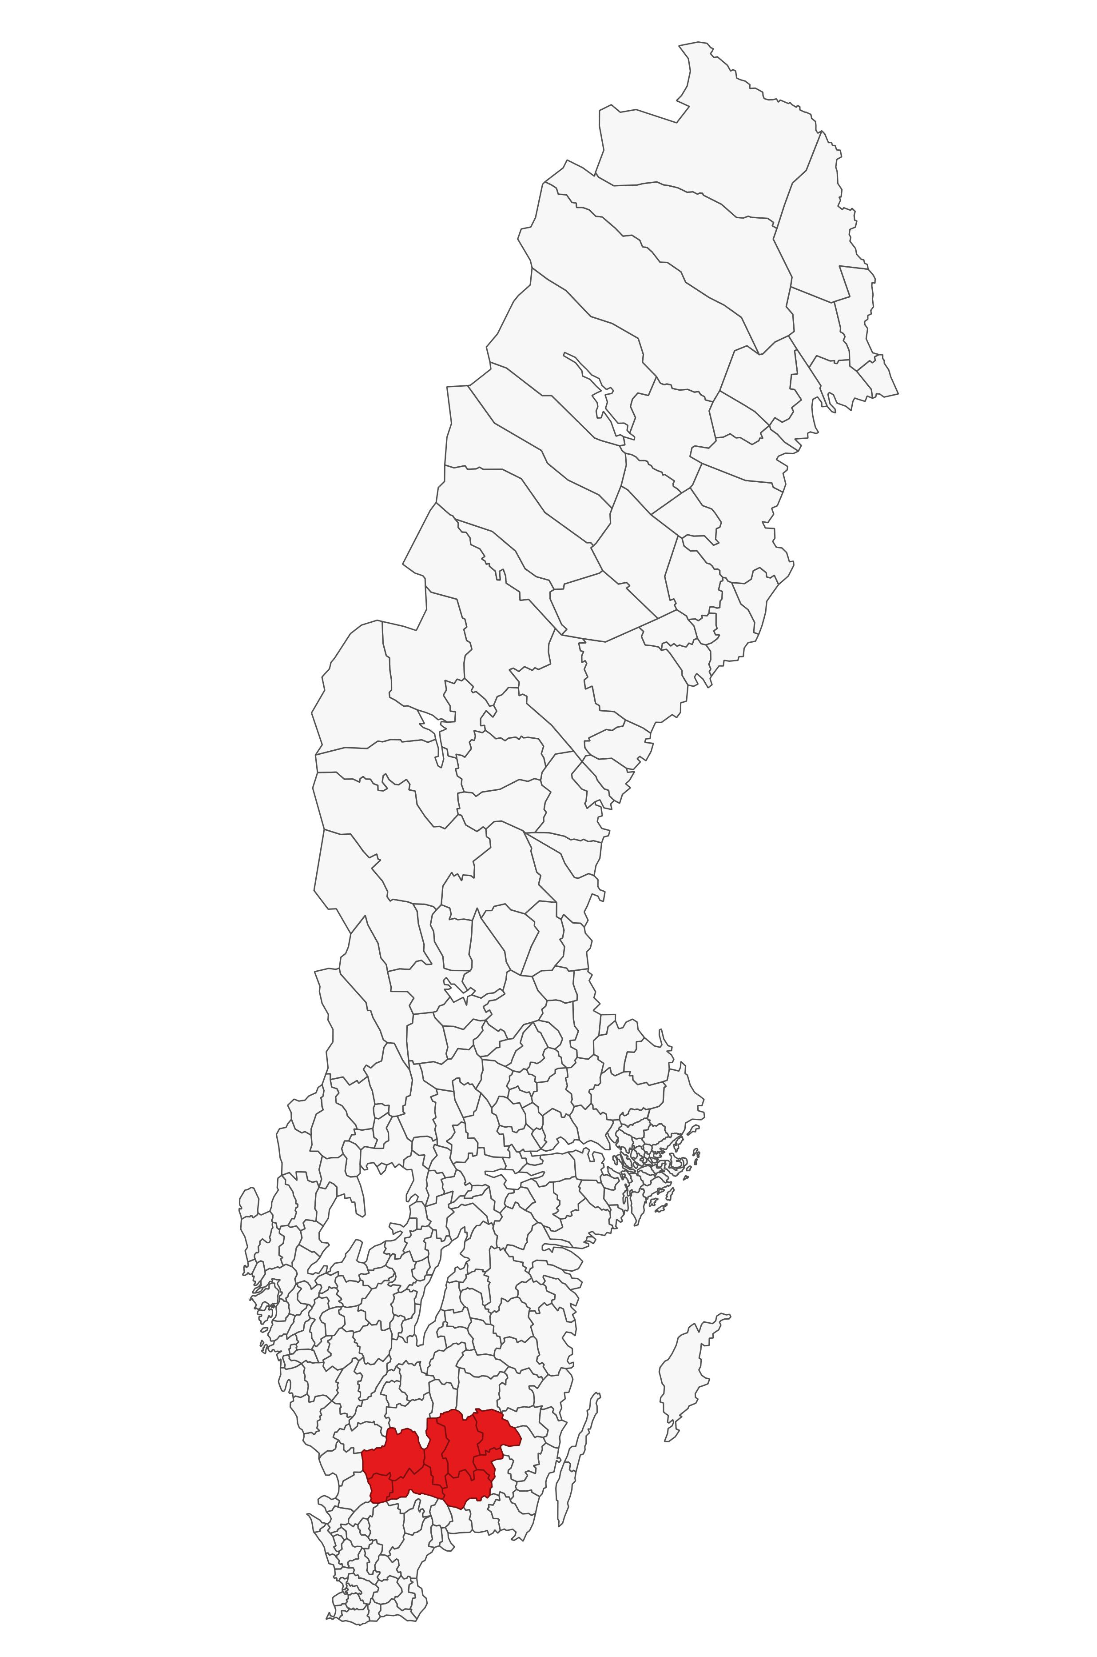
County of Kronoberg in southern Sweden
8 Municipalities
200 000 inhabitants
8 500 km²
24 inhabitants/km²
Two cities (Urban)
Six small towns (Sub-urban)
A lot of small villages (Sub-rural)
A large countryside (Rural)
5

Slide 6
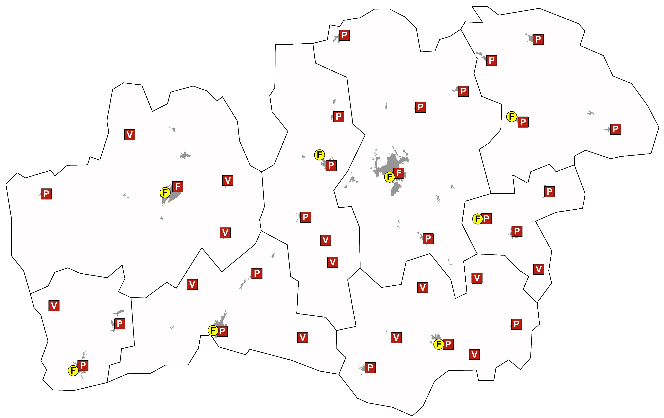
EMS and FRS stations in Kronoberg
EMS and FRS stations
F
EMS (Full time)
F
FRS (Full time)
P
FRS (Part time)
V
FRS (Volunteer)
6

Slide 7
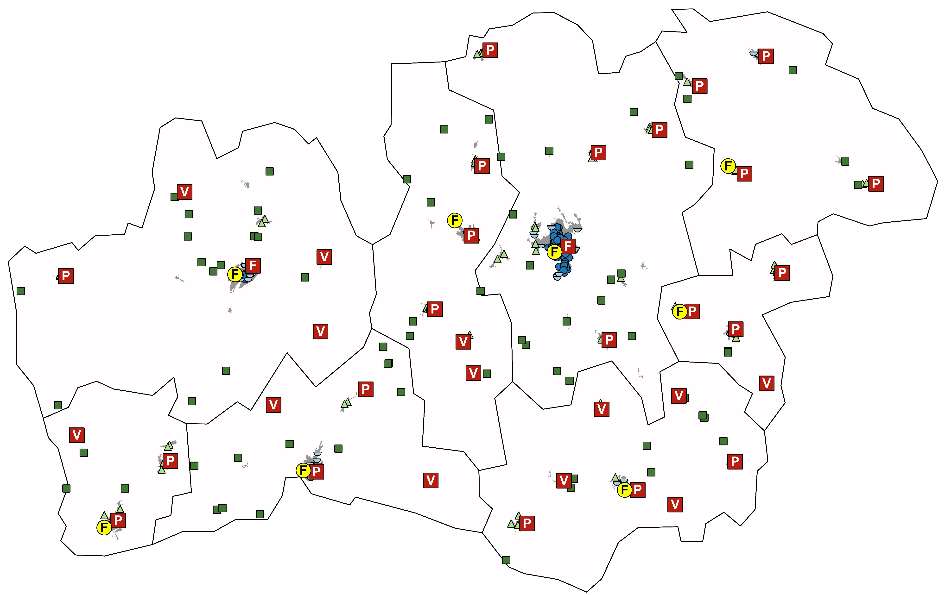
285 OHCAs
between 1 July 2020 and 31 December 2021
F
EMS (Full time)
F
FRS Heltid (Full time)
P
FRS (Part time)
V
FRS (Volunteer)
”Rural” (n=71)
”Sub rural” (n=71)
”Sub-urban” (n=71)
”Urban” (n=72)
7

Slide 8
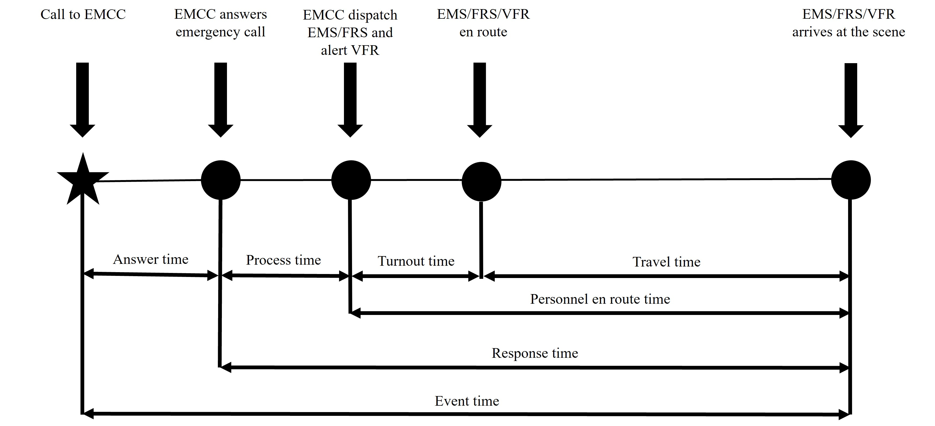
8

Slide 9
50 meters
9

Slide 10
Urban
Number (median) of alerted VFR
30
Number (median) of VFR-accepted assignments
7 (23% of alerted)
Linear distance in meters (median) for first VFR to arrive at the scene
515 meters (min-max 26–2262 meters)
Response time (median)
VFR – 7:03
FRS– 8:37
EMS – 8:07
10 000 meters
10

Slide 11
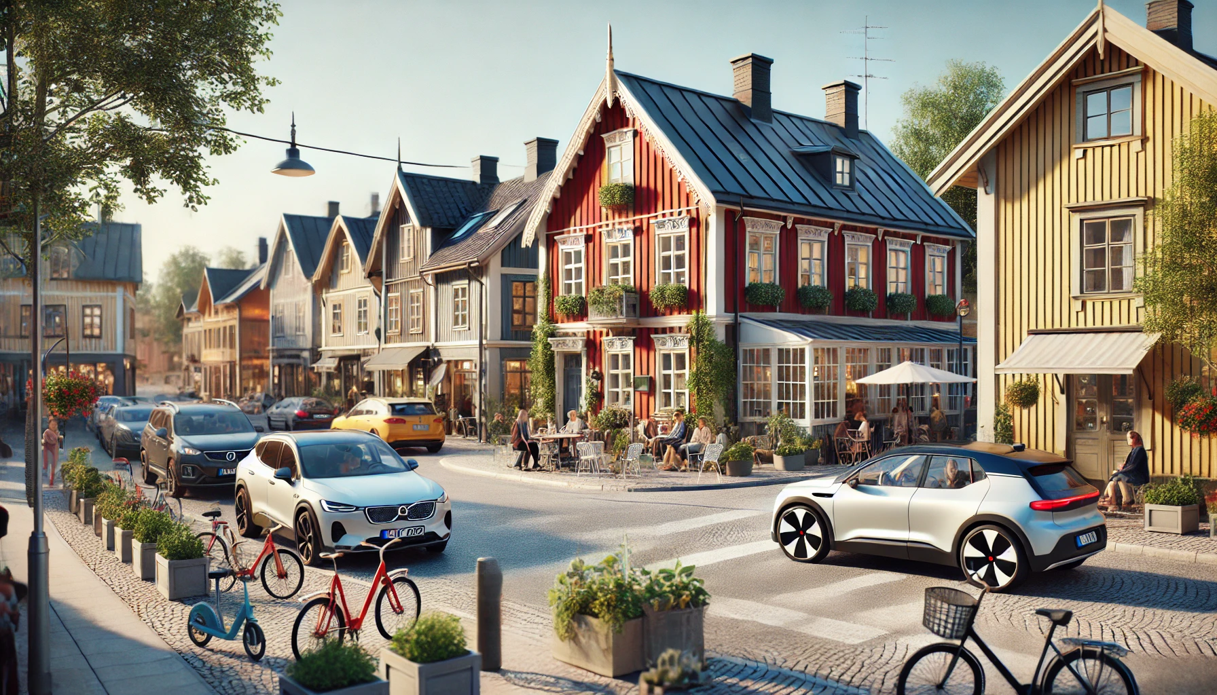
Sub-urban
Number (median) of alerted VFR
30
Number (median) of VFR-accepted assignments
6 (20% of alerted)
Linear distance in meters (median) for first VFR to arrive at the scene
887 meters (min-max 60–7524 meters)
Response time (median)
VFR – 6:10
FRS– 8:00
EMS – 9:52
10 000 meters
11

Slide 12
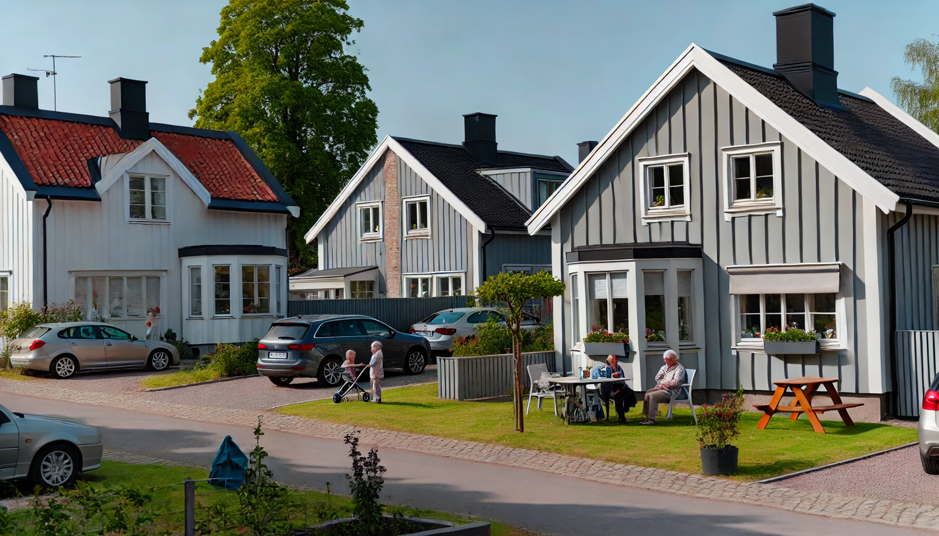
Sub-rural
Number (median) of alerted VFR
11
Number (median) of VFR-accepted assignments
3 (27% of alerted)
Linear distance in meters (median) for first VFR to arrive at the scene
604 meters (min-max 28–9996 meters)
Response time (median)
VFR – 6:28
FRS– 9:37
EMS – 16:27
10 000 meters
12

Slide 13
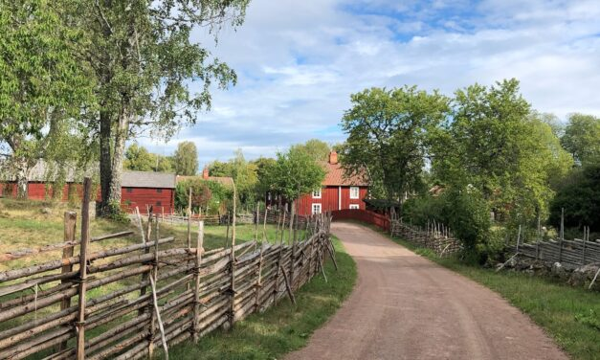
Rural
Number (median) of alerted VFR
14
Number (median) of VFR-accepted assignments
3 (21% of alerted)
Linear distance in meters (median) for first VFR to arrive at the scene
3747 meters (min-max 346–9744 meter)
Response time (median)
VFR – 12:37
FRS– 14:10
EMS – 19:03
10 000 meters
13

Slide 14
First on scene in 285 OHCA
132 (46%) 78 (27%) 75 (26%)
14

Slide 15
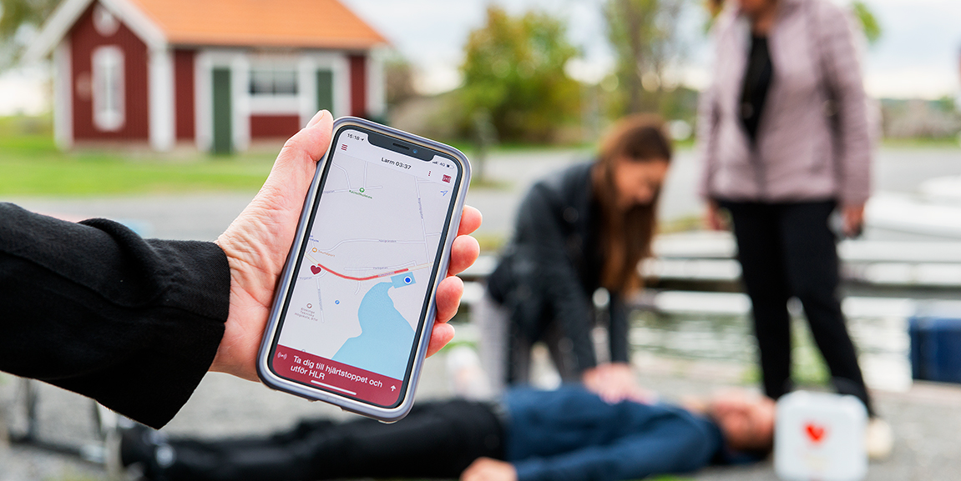
"It's far to the neighbors... if you're in the city, everything is close, but here it's a long way to the ambulance. That makes me feel a greater responsibility to respond to these calls, a stronger commitment to go on these missions than if it were in the city, where I truly feel I can make a difference."
Voluntary frst responders’ experiences
of being dispatched to suspected
OHCA in rural areas:
A strong desire to help, this is expressed as even more important when living in rural areas.
Acting as an VFR at OHCA in rural areas involves emotional and ethical challenges.
There is a need to develop, implement, and evaluate support for VFR, a need that can be considered even greater for those people operating in rural areas.
"It's a bit special living in a small village because it's so small, and whoever you go to, you know the person. That always makes it feel a bit extra, especially when you see the address and immediately know who it is."
"You meet this family whether you want to or not, so it's not like you can just do the task and then let it go; I see them every day."
15

Slide 16
Conclusion
The differences found in median response times between rural and urban areas are worrisome from an equality perspective.
VFR had the shortest median response time to OHCA in comparison to EMS and FRS in all studied population densities. However, in one-third of the OHCAs, no VFR arrives at the scene. Therefore, more focus should be put on recruiting VFR, especially in rural areas.
EMS, FRS and VFR complement each other in a favourable way, creating effective cooperation between professions and volunteers, assisting and providing emergency care to people in need.
16

Slide 17
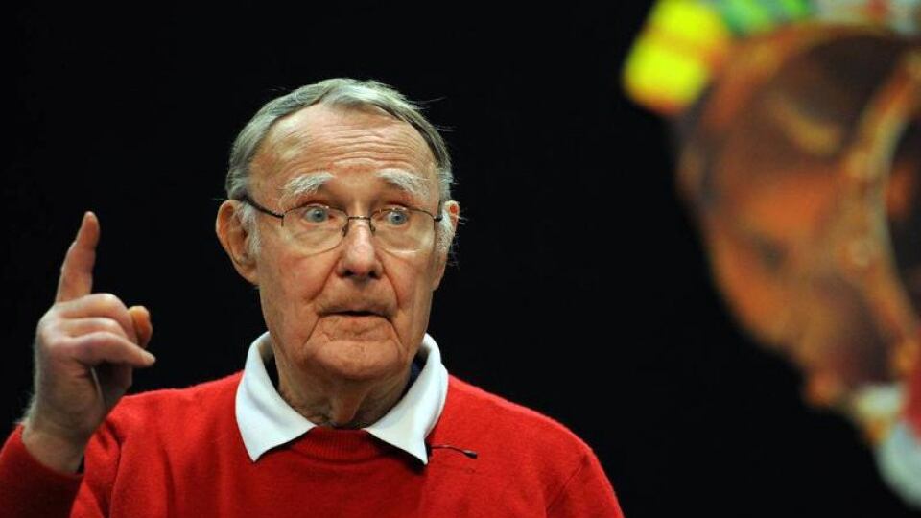
Most things still remain to be done.
A glorious future!
Ingvar Kamprad
The Testament of a Furniture Dealer, 1976
The studies was funded by the Kamprad Family Foundation for Entrepreneurship, Research, & Charity (reg. no. 20202001).

