Slide 1
Tech transitions: Implementing Change Effectively in the Emergency Field
EENA-webinar 24.9.2024
Patrick Tiainen
Communications specialist, Emergency Response Centre Agency Finland

Slide 2
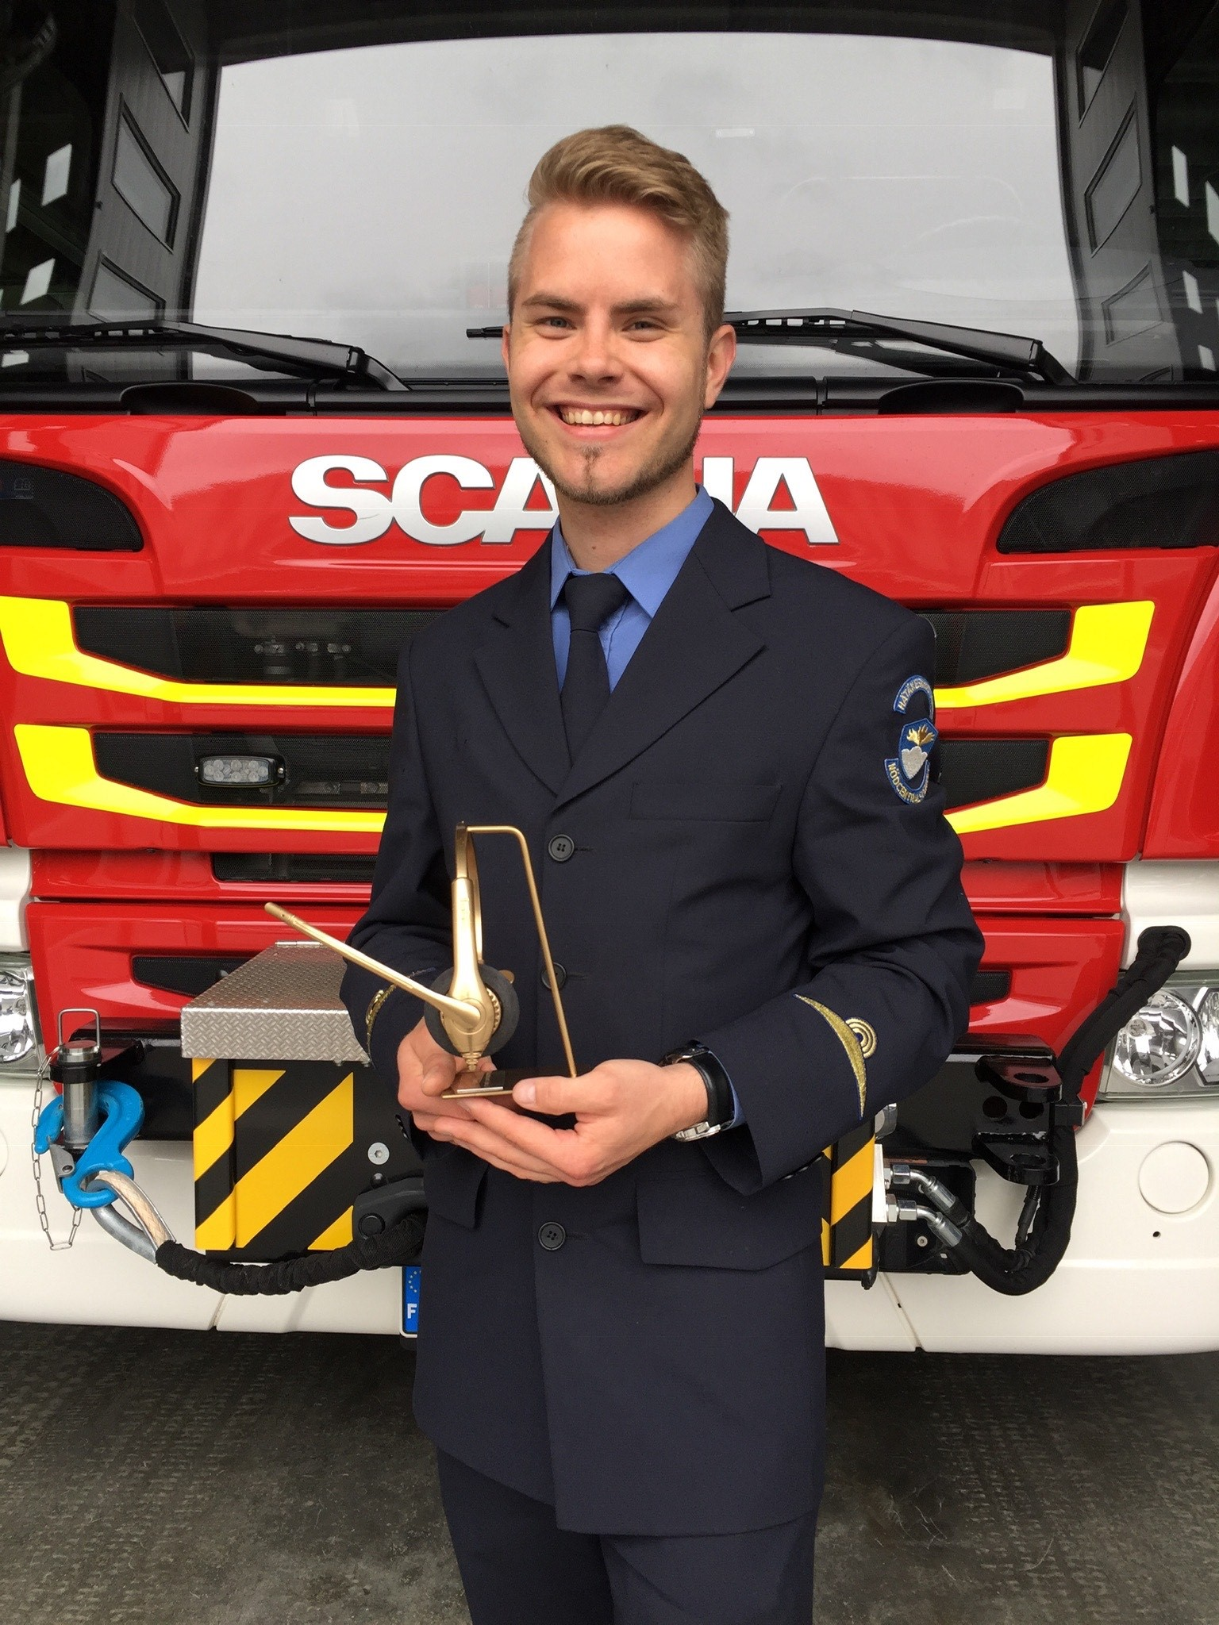
An operators path
Emergency Services College 2018 (90sp)
Employment at 112 Finland
Further training at the ERC
Senior dispatcher, specialist role

Slide 3
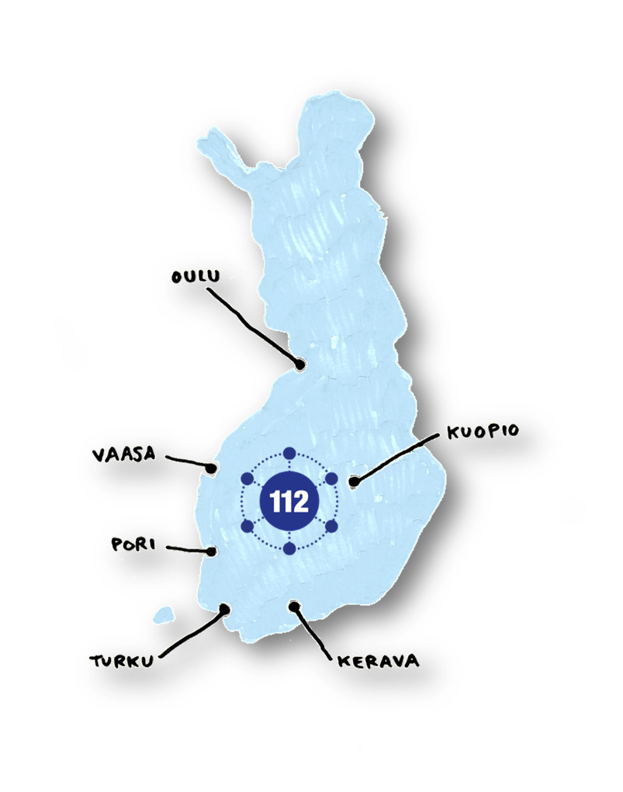
112 Finland
Finland has six ERC’s, approximately 600 ERC proferssionals
A common emergency number for all authorities – the same operator is responsible for risk assessment, dispatching and giving instructions to the caller
Language minorities, emergency SMS, 112 Suomi -app

Slide 4
A brief look back
The state agency started its work in 2001, and in 2005 the number of ERC’s was 15.
There was a need to make the system more efficient, stable and standardize national models of working
In 2015 the number of centers was cut down to six, but the system did not support a networked model of working. It was still vulnerable. A new project was started in 2008 to create a new system – ERICA, Emergency Response Integrated Common Authorities.

Slide 5
A networked model
ERICA was finally taken into operational use in 2019, one centre at a time. It brought a number of new features.
Six centres now created one, virtual centre
The networked model means that calls overflow in two phases: the first phase is implemented through ERC pairs, and in the second phase calls are shared between all ERC’s → calls from anywhere in Finland
Automatic geopositioning of caller
Integrated risk analysis
Integrated communication tool (phone, TETRA radio, emergency SMS)
Real-time response time of units/drive-time calculation
Dispatch calculation/response proposal

Slide 6
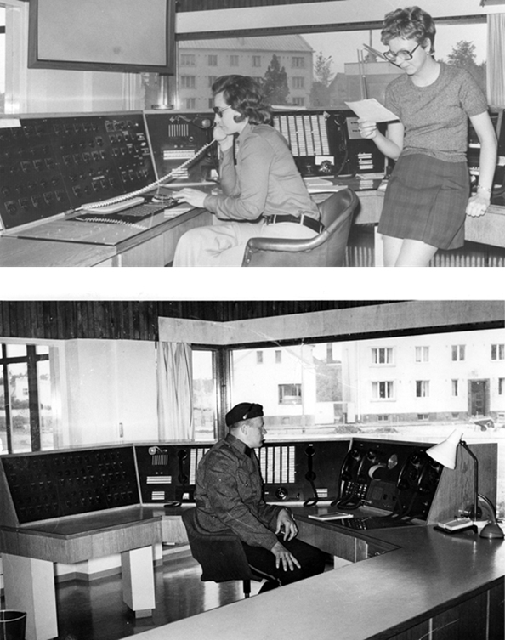
Benefits of ERICA
The networked information system enables optimal use of the resources of the emergency response centres.
It enables obtaining a real-time situational picture of the internal security in the whole country in a centralized manner.
The ERICA system is used by the Emergency Response Centre Agency, police, fire and rescue, health and social services, as well as border guard to update the information of their units and risk analysis as well as for command and control center purposes. This means 50+ sites.

Slide 7
Challenges faced
The development period and costs: are ICT-systems any longer new as they’re ready to be used? Technology is advancing at a great speed.
Sometimes change in technology also leads to a great change in how the work is perceived. With the dispatch proposal, the built in risk-assessement tool and automatic answering the decision making during the call got automatized to some degree, which led to a loss of perceived job control. Perceived job control is crucial to job security and the psychological aspects of work health. Job control is also a resilience factor in preventing trauma!
Over-alerting, difficulties in understanding the algorithm.
A long development period might lead to loss of information of the blueprint.
The agency lost a great number of employees during the turbulent year(s).

Slide 8
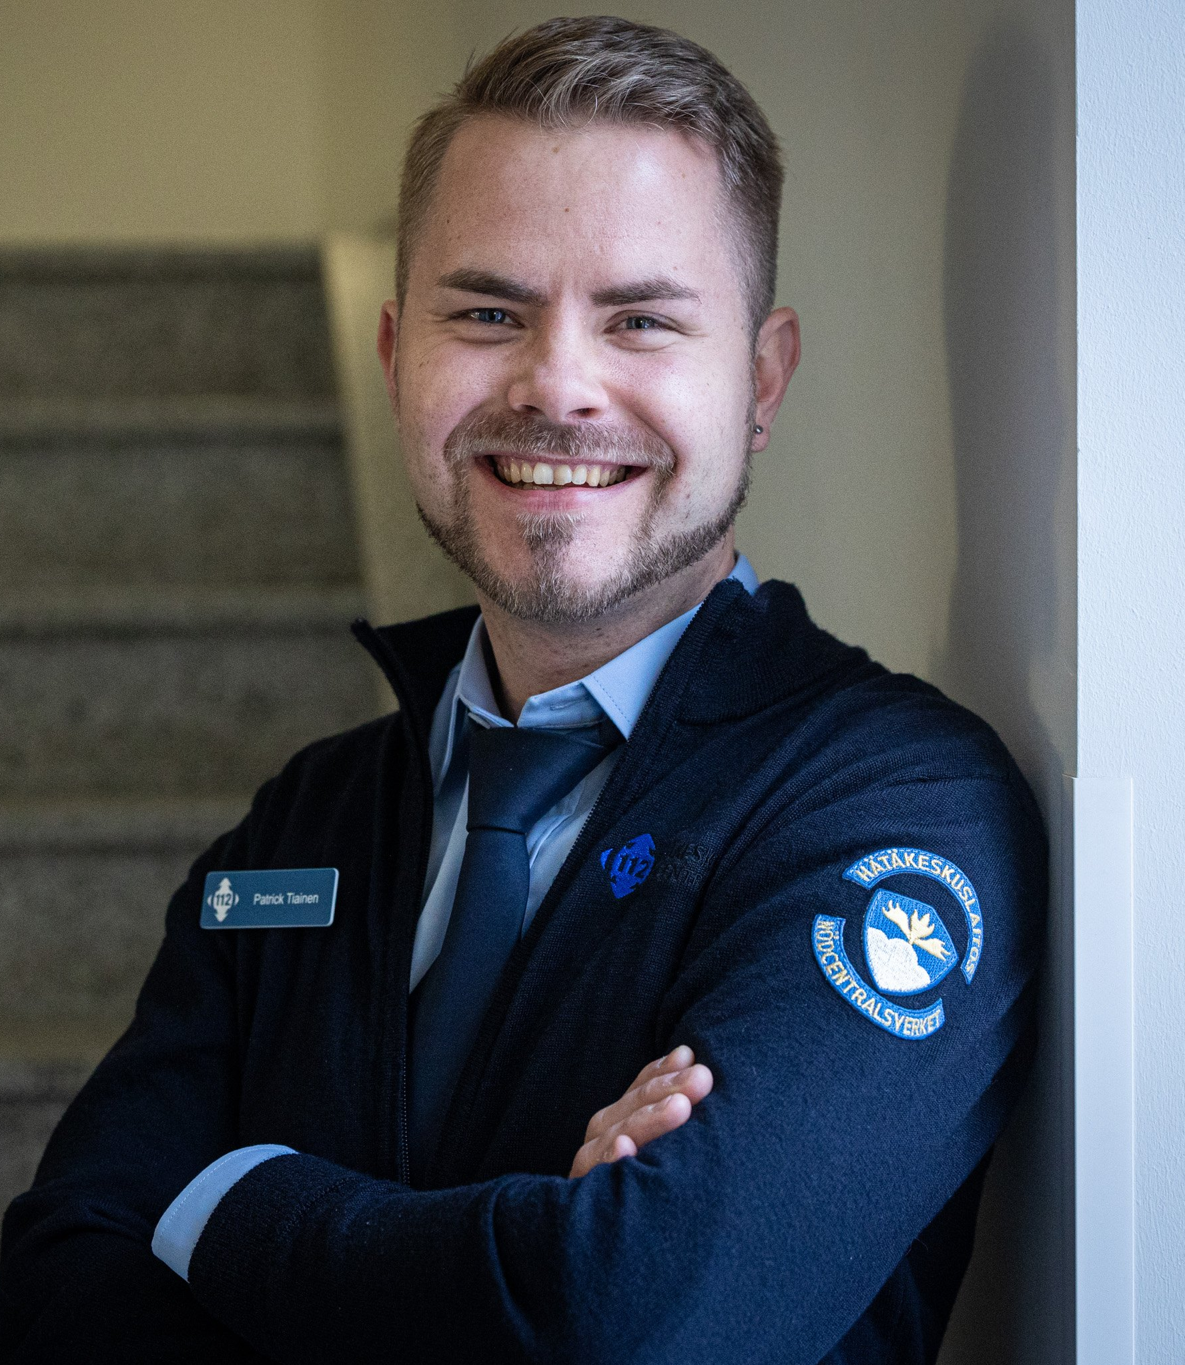
Low job control combined with high demands and exposure to potentially traumatizing events is a psychosocial hazard.

Slide 9
Outcomes & future vision
The dispatch calculation was too sensitive, and over-alerting had to be fixed quickly.
An in-built tool for feedback was released.
Next was the automatic answering feature: this was made optional, enabling manual aswering mode.
The integrated tool for risk-assessment proved to be too rigid, and it gave too little room for the use of expertise. This was changed, and the old model was re-introduced.
New instructions were published quarterly to support training.
Greater focus on the personnel, shift in leadership (leading people instead of leading things and projects).
The six centres were given greater freedom even as the networked model was kept in place.
Stressing quality over time.

Slide 10
The future vision includes strengthening the abilities of the situation centres to use the system in an optimal way.
The personnel is greatly involved in the decisionmaking and further development of the system. Operators still use the inbuilt feedback-tool on a regular basis.
Greater use of the national, situational picture is underway.

Slide 11
Kiitos! Thank you!

