Slide 1
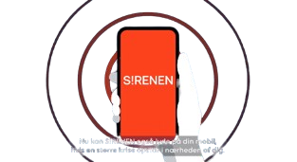
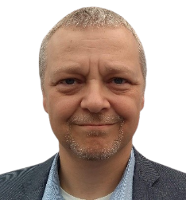
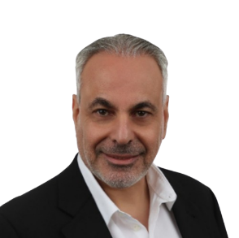
Mitigating Disasters with Utimaco’s Public Warning systems & Event Management
u.warn
u.warn
Public Warning Systems
Deployment in Denmark
Bjarne Siewertsen
Deputy head,
Communications & warning,
Danish Emergency Management Agency
Ronen Daniel
Head,
Warning Solutions
Utimaco

Slide 2
Agenda
Intro to DEMA and Utimaco
Project objectives and timelines
Vendor selection process and reasons for selecting Utimaco
System topology and architecture
Cooperation with the MNOs
CAP Customizations
Working with Apple and Google
Deployment challenges
Cooperation with other governments in the region
System activation post commissioning
Beyond cell broadcast
Project summary and conclusions
Q&A

Slide 3
DEMA – Danish Emergency Management Agency
DEMA operates under the Ministry for Resilience and Preparedness and has a charter focused on preparedness, response, and recovery in emergency situations
Mission
DEMA aims to minimize the impact of emergencies on society and improve resilience through effective planning, training, and collaboration among stakeholders
Main Responsibilities
Emergency Preparedness
Crisis Management
Public Warning systems
Public Education
Collaboration
Works closely with the police, local municipalities, emergency services, the military, and other government agencies to ensure a coordinated response to emergencies

Slide 4
Utimaco
Diversity and internationality are the key to our success
Headquarters
Subsidiaries
Customer and partner network
EMEA HQ Aachen, Germany
UTIMACO TS UK Ltd. Farnborough, UK
Americas HQ Campbell, USA
UTIMACO TS S.R.L. Milano, Italy
Singapore
Utimaco Tech. Ltd.
Herzliya, Israel
Utimaco Tech. Pvt. Ltd.
Mumbai, India
Founded 1964
40 years in IT security
600 highly skilled experts
130 million Euro
revenue in FY 22/23
Private company

Slide 5
85 CBE/CBC implementations worldwide
LITHUANIA
BITE
Telia
TELE2
BELARUS
MTS
Velcom
EUROPE/ CEE
Sweden
3
RUSSIA
Vimpelcom
Denmark
DALO
3
AZERBAIJAN
Azercell
Azerfon
Denmark
Austria
Vienna
3
Israel
JERSEY
Jersey Telecom
MONGOLIA
Mobicom
CHINA
China Unicom
BANGLADESH
Robi
UKRAINE
Kievstar
Vodafone
Lifecell
VIETNAM
VMS
Vinaphone
Viettel
Vietnam Mobile
Mexico
Telcel
PAKISTAN
PakTel
Vienna
DOMINICAN REPUBLIC
Claro
GREECE
Nokia (Ergose)
India (AP)
JAMAICA
C&W
TURKEY
AVEA
TAIWAN
TWM
APT
TST
PUERTO RICO
Claro
CAMBODIA
CAMgsm
HONDURAS
Claro
NICARAGUA
Claro
Qatar
MOI
Vodafone
PHILIPPINES
Globe
BURKINA FASO
TelMob
Ukraine
COSTA RICA
Ice
ECUADOR
Claro
SOMALIA
Somtel
INDONESIA
Telkomsel
Hutch
Qatar
TOGO
TogoCell
PERU
Claro
INDIA
Vodafone
Idea
Airtel
BSNL
Reliance
Aircel
APSDMA
CALA
BRAZIL
Brazil Telecom
Claro
Telemig/Vivo
UGANDA
UTL
Warid
ISRAEL
IDF
Pelephone
Cellcom
Partner
Hot Mobile
THAILAND
AIS
SRI-LANKA
Dialog
Mobitel
Airtel
Ukraine
CHILE
Claro
ARGENTIA
Movistar
ME & Africa
APAC

Slide 6
S!RENEN - project objectives and key milestones
Objectives
Establish a multi-channel, reliable, nationwide alert system
Ensure rapid communication with residents and visitors during emergencies
Severe weather conditions
Terrorist Threats and Security Incidents
Chemical or Industrial Accidents
Pandemic or Disease Outbreaks
Key milestones
2020: Project officially begins
2021: Vendors selection; design finalizations
2022: Initial testing and pilots
2023: Service launch

Slide 7
Vendors Selection
DEMA gave the 3 MNOs in Denmark the freedom to select its own CBC vendors
CBE Selection process:
2020 - RFI
2021 - Pre-qualification
2022 - RFP (3 vendors) and award
Reasons for selecting Utimaco
Utimaco was the only vendor which actually read the tender and replied to the specifics
Before final selection, Utimaco began offering sane advice

Slide 8
Distributed Topology
CBE Command Post
Nokia
CBC
RAN Controllers
4G/5G
CBC
RAN Controllers
4G/5G
Everbridge
CBC
RAN Controllers
4G/5G

Slide 9
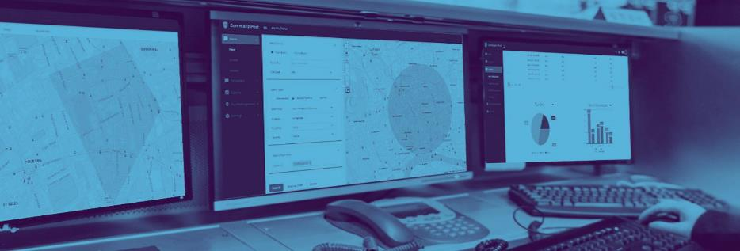
u.warn Command Post (CBE)
A central alert creation & management tool for all delivery channels
Predefined alert templates and libraries
Predefined target areas
Customized workflow
3 Levels
Multiple alert languages
Danish / English
Easy to use customized GUI
Multiple government agencies
Hundreds of users
Users’ roles and responsibilities Management
Cell broadcast
Sirens
Social media
Galileo
Emergency apps
TV
Radio
Billboards
Email

Slide 10
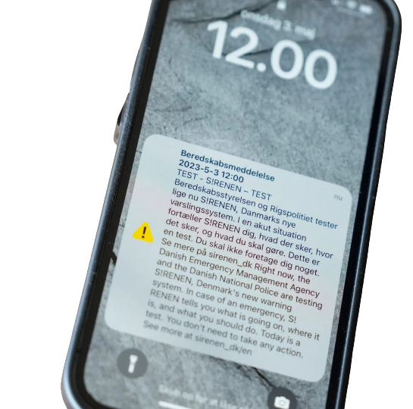
u.warn CBC
Realtime & location-based alerts
Works also when the network is jammed
Does not exhaust network resources
Does not require data
Compatible with all networks 5G; 4G; 3G; 2G
Supports all RAN/core vendors
Best of breed performance wise
Full geo-redundancy (active-active)
Complies with all emergency standards (CMAS, EU-Alert…)

Slide 11
System architecture accents
3 Systems
DEMO
STAGING
PRODUCTION
Gates locking/unlocking
Power outlets
Cameras / drones
Pumps
Demonstration and testing of new features
Training
Connected only to simulators and not to any live equipment
Full mirroring of the production system
Integrated to MNOs’ staging CBCs
Utilized for testing new SW versions before production

Slide 12
High Resilience
GEO REDUNDANCY
CI/CD
DISASTER RECOVERY
All dynamic information (databases, cache memory, etc.) are continuously replicated online, or stored in a cluster-based setup
This avoid any loss of data at any given moment
Both sites of the production and staging systems can work independently
This allows SW and OS upgrades without bringing the service down
Service is always on
All data and configurations are stored in a secured location
1 hour recovery from full system (both GR sites) failure
Zero downtime

Slide 13
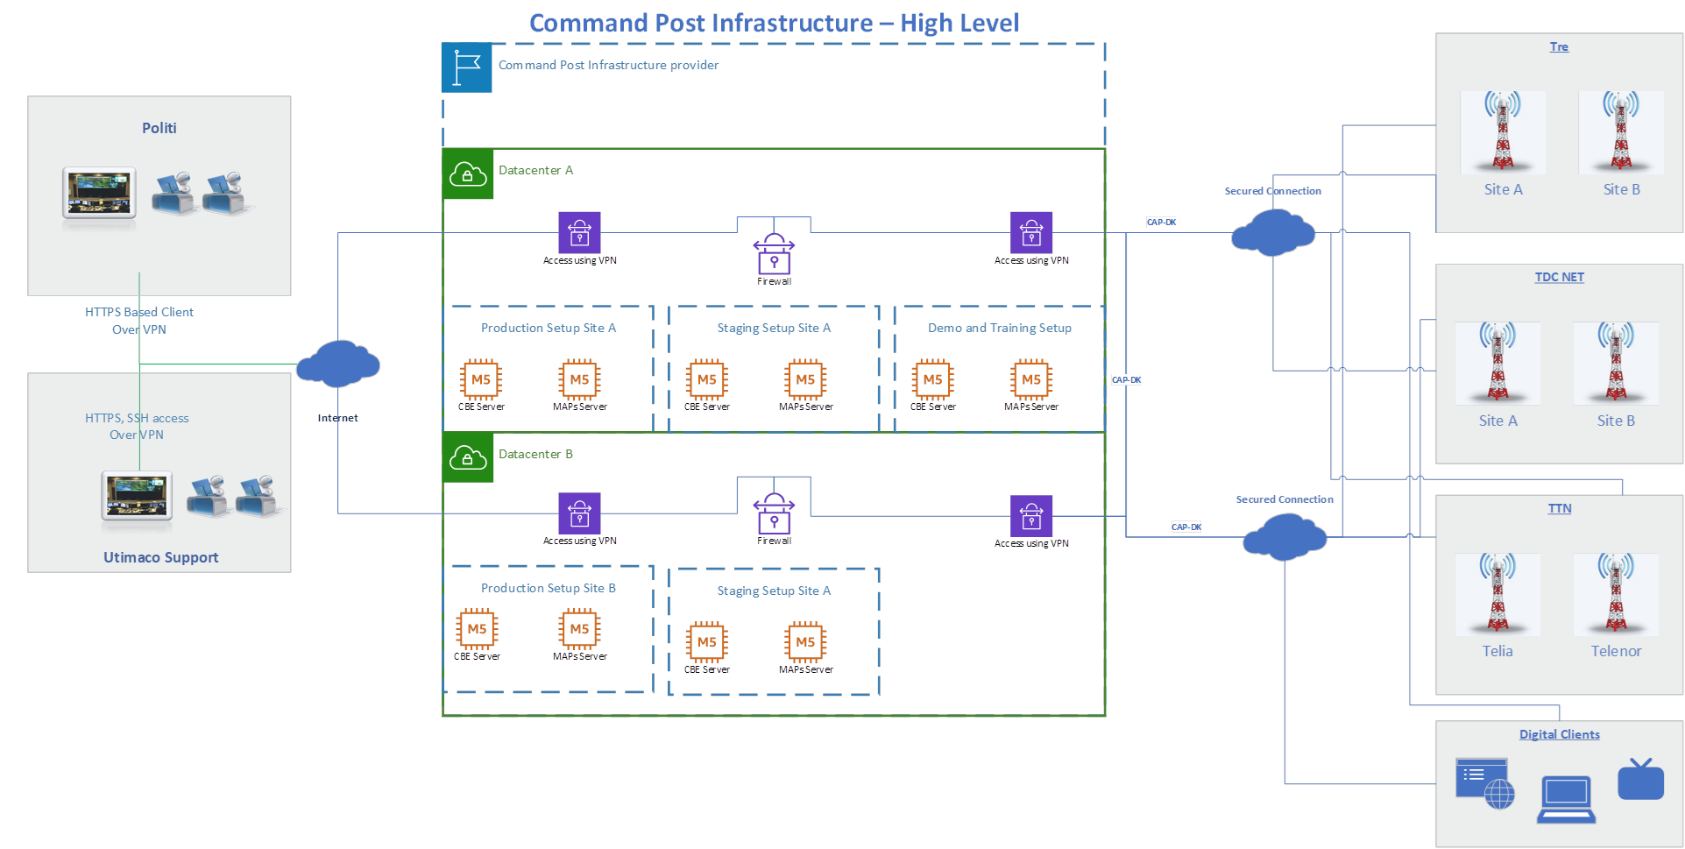
Zero Downtime – Active/Active Configuration

Slide 14
Cooperation with the MNOs
As to cell broadcast, a good cooperation with the MNOs is crucial for the project success.
In Denmark, complying with PWS is obliged by the MNOs license
We wanted to work with the MNOs as our partners from the very beginning
We have agreed together on reasonable timelines for the CBCs installation and integration
We have made it clear to them at the very beginning that we will carry out all their project related expanses
We gave the freedom to the MNOs to select their CBC vendors
We ended up with 3 different CBC vendors for the 3 MNOs ☺
Luckily, one of the MNOs had also selected the Utimaco CBC, which helped a lot in finalizing the CAP interface and all CBCs integration down the road.

Slide 15
CAP customization
CAP – Common Alerting Protocol
CAP 1.2 is often used as the primary interface between the various components of Public Warning Systems
Reason for choosing CAP are:
An international standard, by OASIS and ITU
Multi-channel Distribution capabilities
XML-based format allowing an easier integration
Supports Geolocation, allowing precise targeting of alerts to specific geographic areas
Since CAP is rather generic, using it as the CBE-CBC interface for cell broadcast, requires customization and fine-tuning
CAP finalization is done in a country level to support the authorities’ specific requirements

Slide 16
CAP adaptation to cell broadcast - examples
Yes/no ♦ Time limit ♦ Historical
HTTP/HTTPS ♦ Signatures (one/both direction) ♦ Authentication (y/n)
Drills ♦ RMT ♦ Technical testing ♦ Logging
Repetition ♦ Geographical scope ♦ Channel selection
Follow original/latest alert ♦ Enabled fields
Yes/No
Data coding scheme
CB Specific
Alert Languages
Alert Scheduling
Update Policy
Statistics
Security
Testing

Slide 17
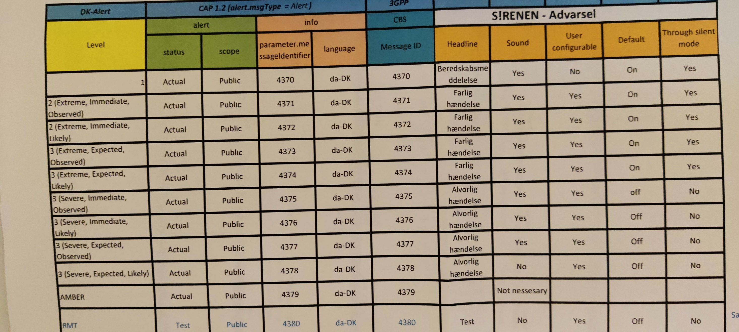
Working with Apple and Google
Direct connection from DEMA/DALO with both
Apple has insisted to perform the testing on the very final system, stretching the timelines
Specifying behavior of all channels

Slide 18
Deployment challenges that we crossed together
Platform changes – we had to change platforms to comply with all stakeholders and timelines. Started with an on-prem solution, all the way up to a distributed cloud-based solution.
CAP DK definition – managed together with Utimaco’s CAP expert, almost from scratch
MNOs day-to-day communication – we had to establish direct relationships between Utimaco and the MNOs and even their CBC vendors, according to the pre-defined playbook.
Enhanced security level to comply with the highest cyber security.
Communication with Apple and Google resulted in numerous meetings.

Slide 19
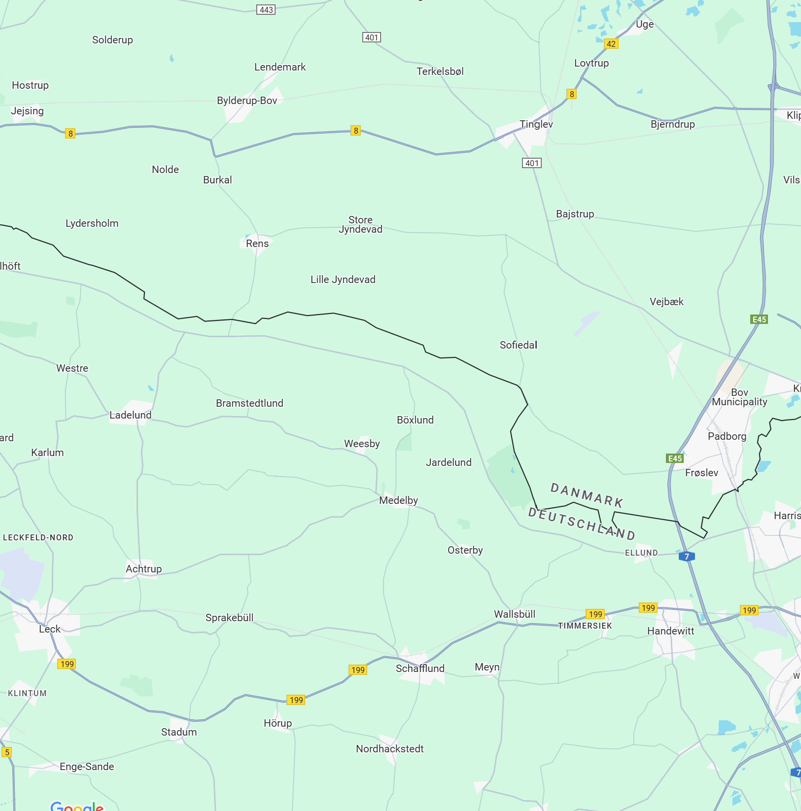
Cooperation with the Germany
Unique cooperation with the German Civil Protection and Disaster Assistance – BBK
Realtime data sharing on close-border incidents that may cross over
In case of an alert being disseminated in either Germany or in Denmark close to the border area, the alert information will be automatically shared with both CBEs, and the other party can decide whether to create a parallel alert at its own area.
In any case, the information kept on our Command Post, allows the system operator to act according to the procedure.

Slide 20
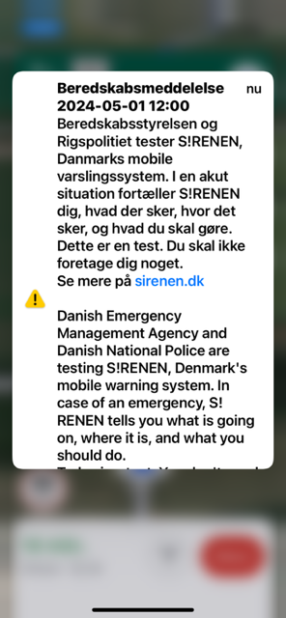
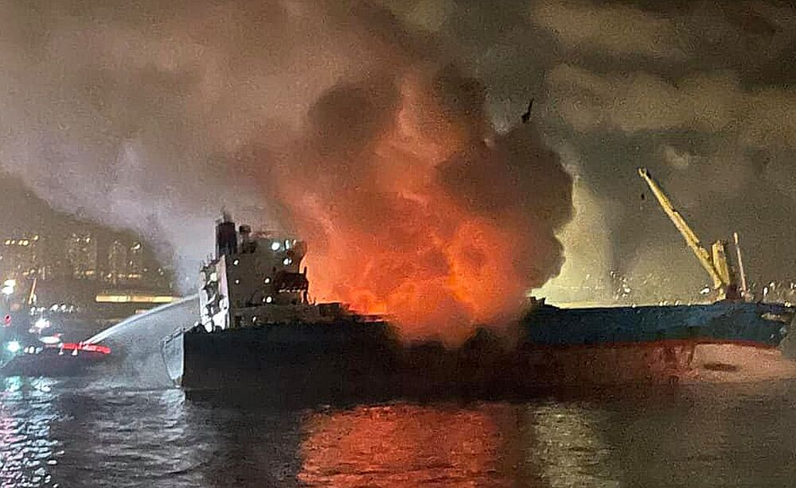
System activations post commissioning
5 operational activations in the past year
1 flooding event
2 large fires in residential areas
2 large fires on garbage ships (month apart in the same city)
2 nationwide tests as part of the annual national emergency alerting testing day

Slide 21
Beyond cell broadcast
As part of our tender, we have requested an option to integrate the CBE with the following additional channels:
Sirens
Automated voice calling
Automated alert sources
SMS Gateway
Google public alert
Since then, priorities have slightly changed, and currently DEMA is working on building a new Siren system.
Also, being considered:
Integration to Galileo
Integration to first responders/emergency apps
Sirens
CB
LB-SMS
App
TV
u.Warn
Utimaco PWS
Radio
billboards
Galileo EWSS

Slide 22
Project summary and conclusions
Project ended on time on budget.
Vendor selection is crucial
Once selecting a vendor, establish a long-term partnership
MNOs must be involved from the very beginning
Post deployment, we have decided to let Utimaco to run the service end-to-end for us
Day-to-day communication with all MNOs, also those with other CBC vendors
System 24x7 monitoring and support
Fault analysis and correction responsibility
Periodical reporting
Monthly review meetings
Maintain recent versions for all SW packages, including 3rd parties

Slide 23
Bjarne Siewertsen
brs-bja@brs.dk
Ronen Daniel
ronen.daniel@utimaco.com

